Slide 1
The Curse of Democracy: Evidence from the 21st Century
Yusuke Narita
Ayumi Sudo

Slide 2
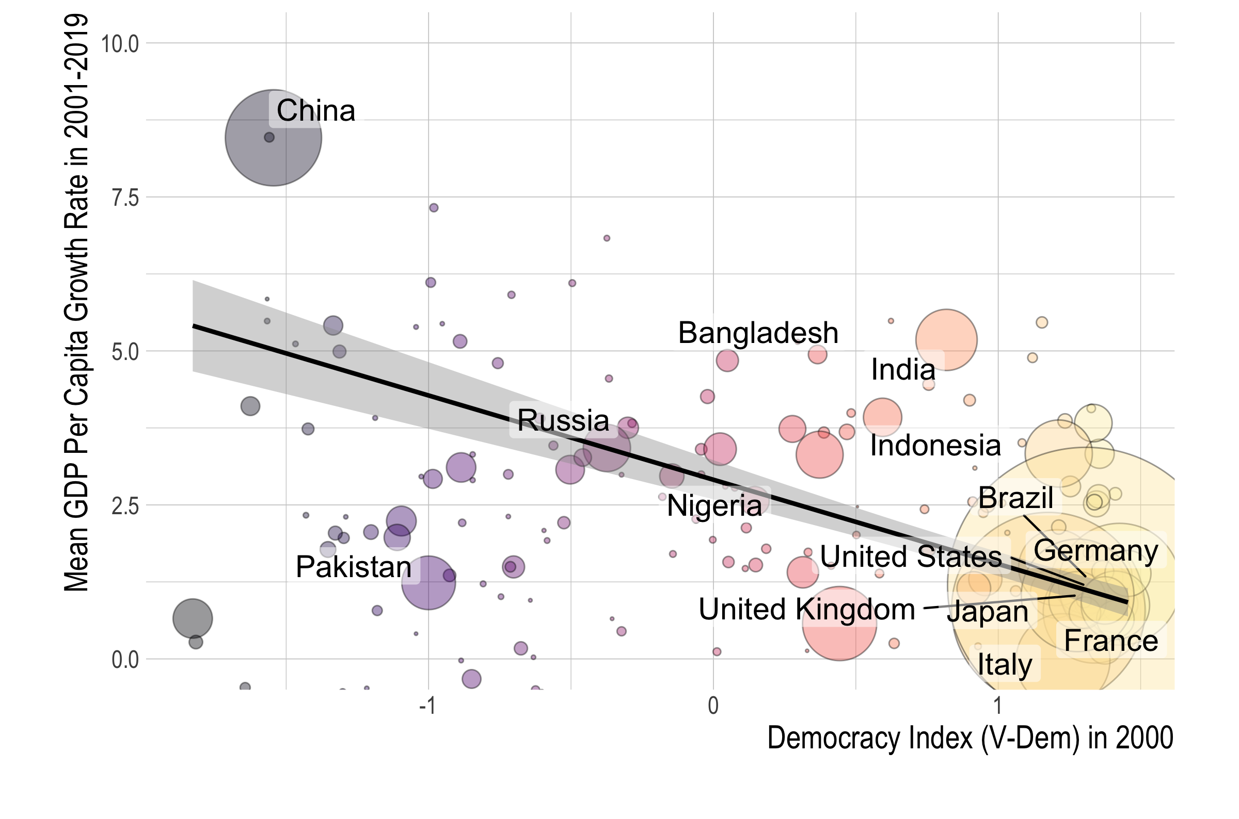
Notes:
This observation is supported by our OLS regression result. This blue line is the fitted OLS regression line that we get with a regression of the democracy index against the GDP growth rate that weights each country by GDP size. The shaded area is the 95% confidence interval.

Slide 3
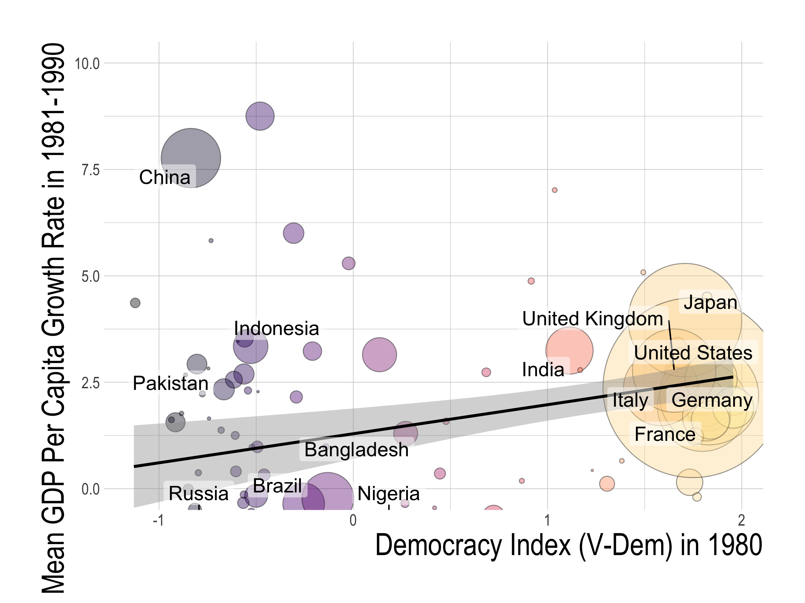
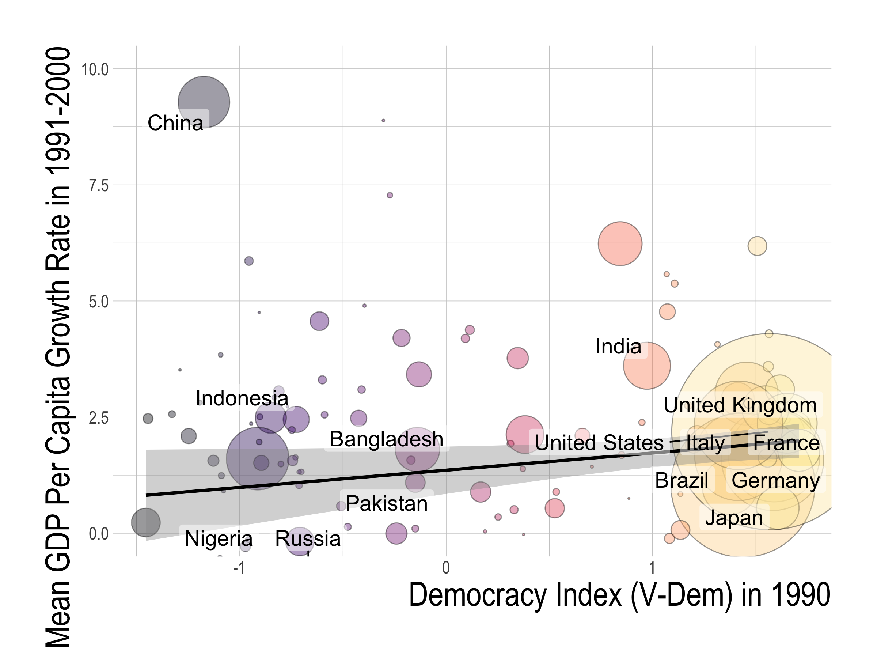
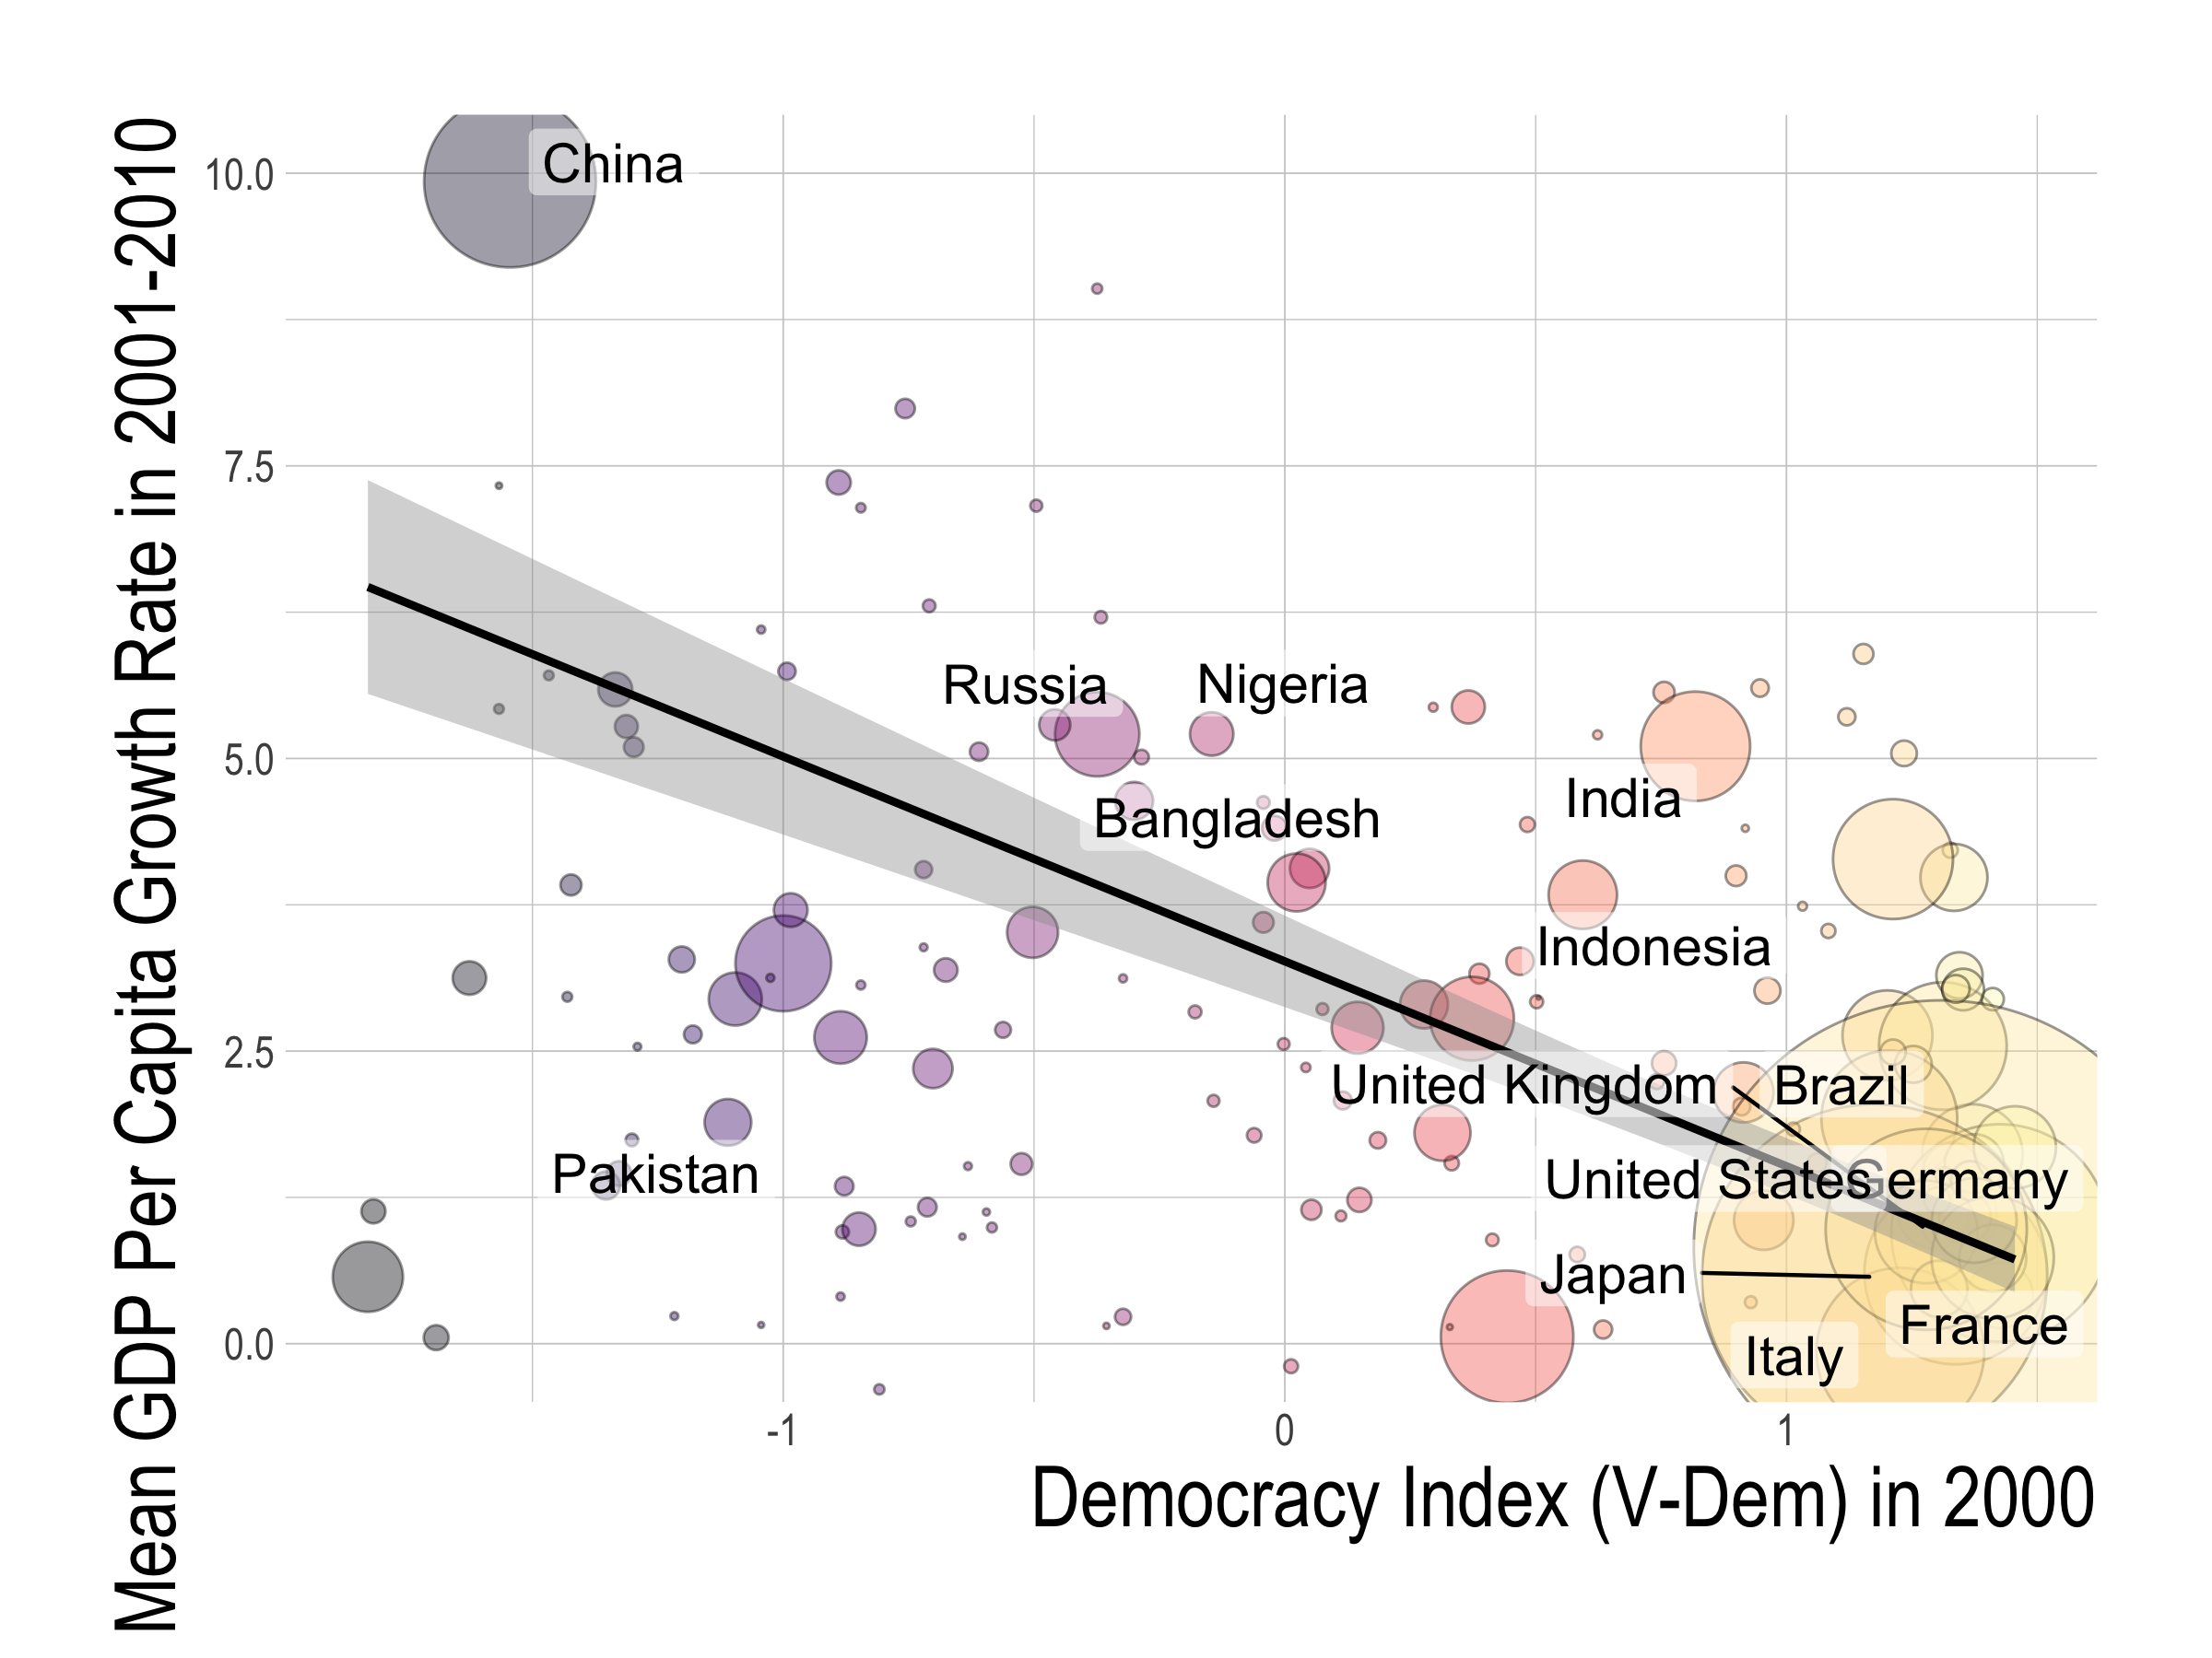
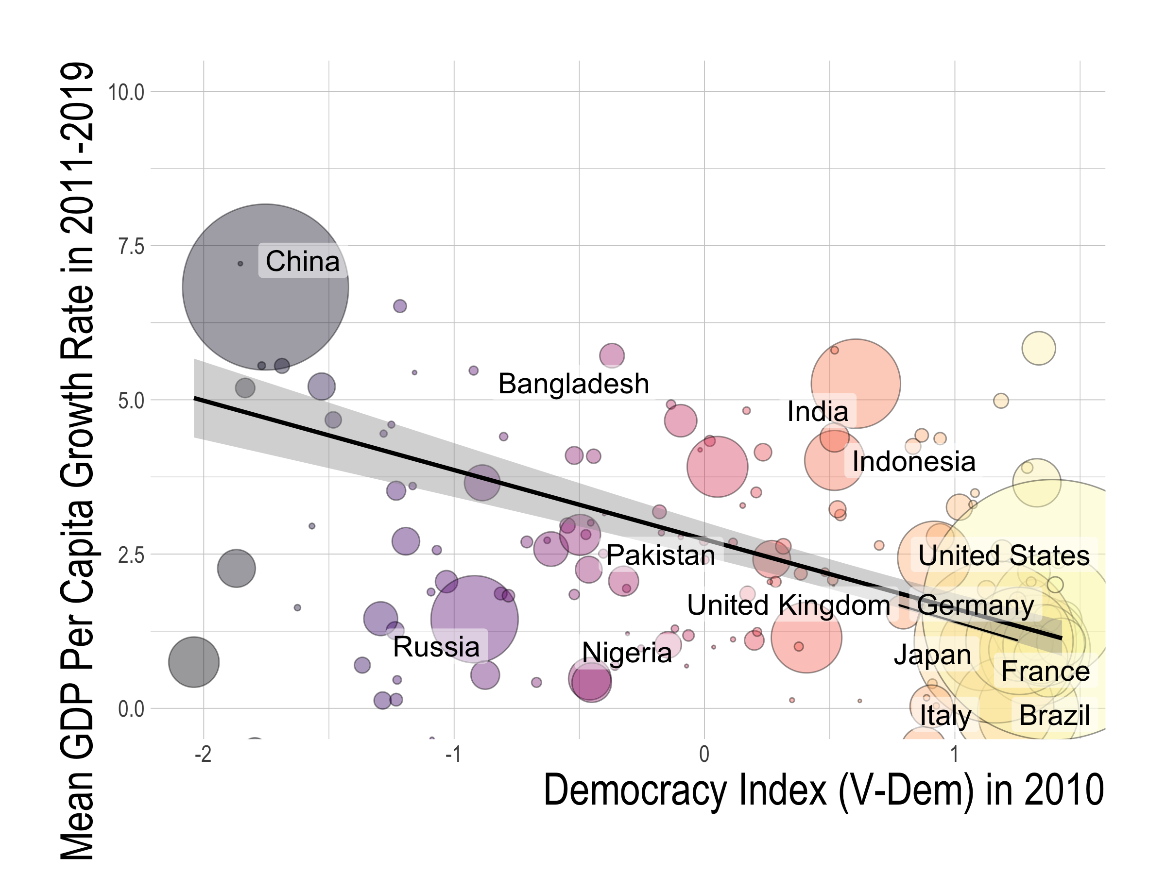
1980s
1990s
2000s
2010s

Slide 4
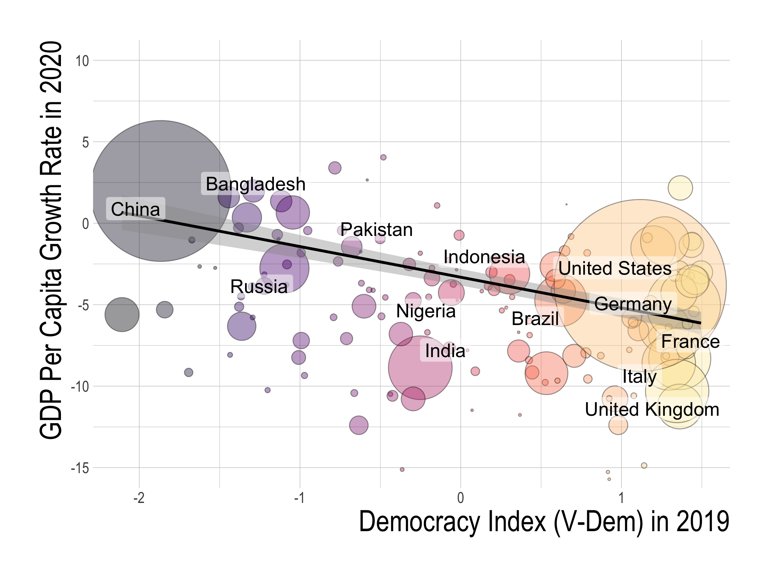

Slide 5
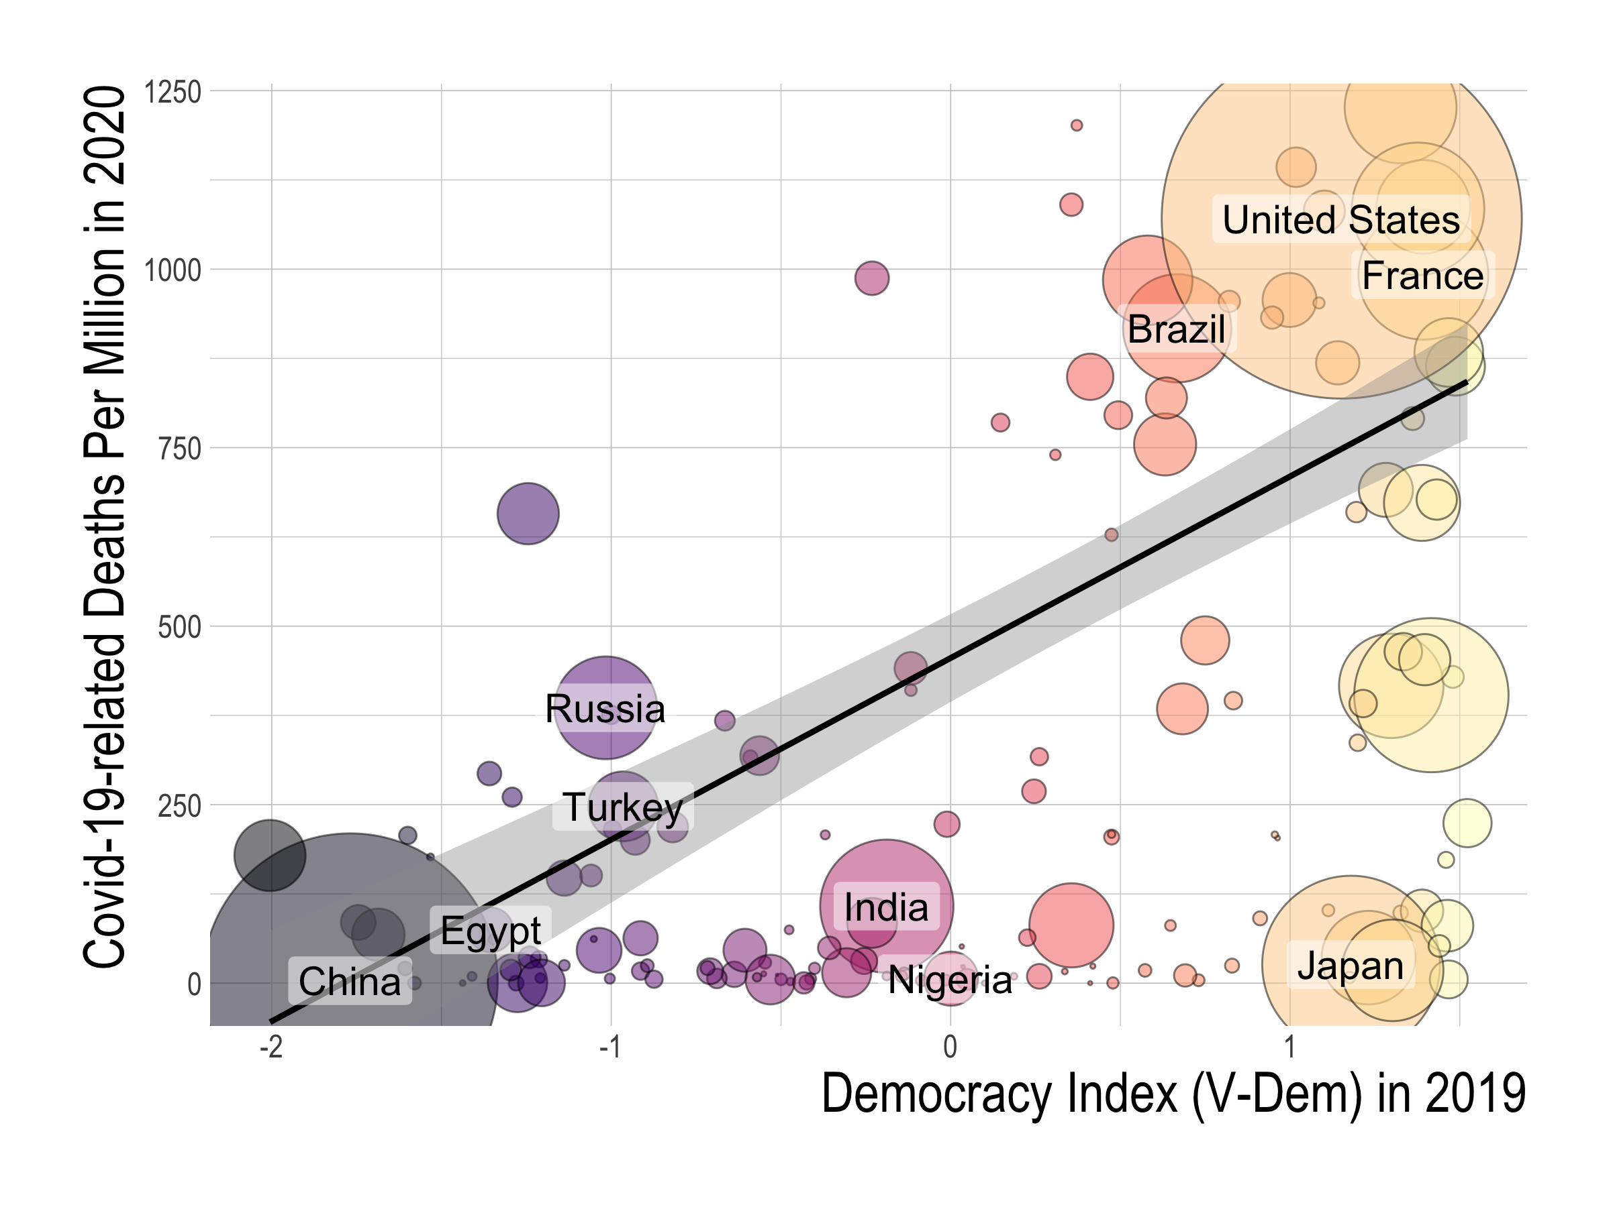
Notes:
.

Slide 6
Our Agenda
Fact: Democracy is associated with worse economic & public health outcomes in this century
Question: Do democratic political regimes cause the worse outcomes?
Empirical strategy: 5 of the most influential IVs for political institutions
European settler mortality (Acemoglu-Johnson-Robinson 01)
Past population density (AJR 02)
Legal origin (LaPorta-Shleifer-Vishny 98)
% speaking English or European (Hall-Jones 99)
Availability of crops & minerals (Easterly-Levine 03)
Notes:
This is the question that we answer in this paper.
Given the context that democracy is strongly associated with worse economic and health outomes in 2020, we ask whether democracy CAUSED these worse outcomes. To do so, we use fve of the ost influential IVs for political and social institutions.

Slide 7
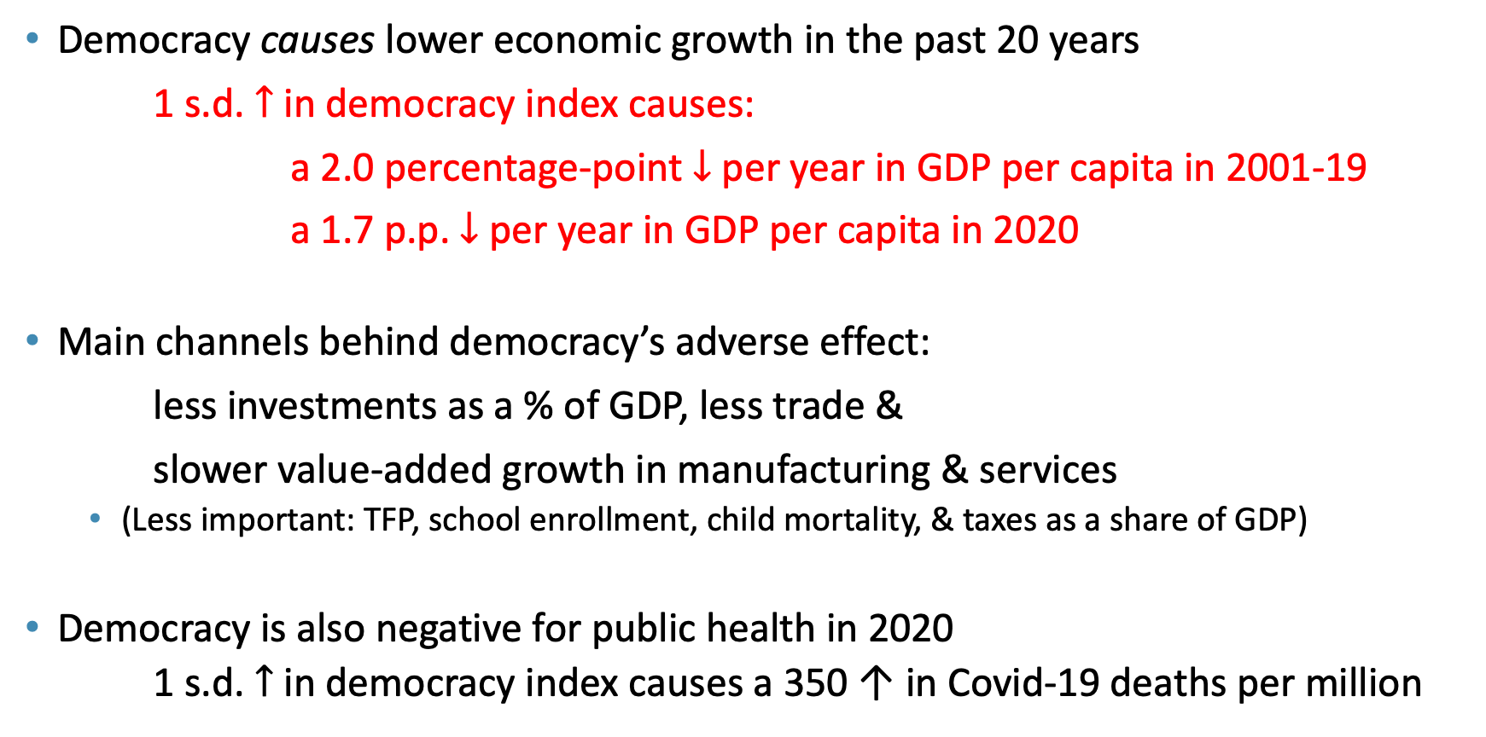
Findings
Democracy causes lower economic growth in the past 20 years
1 s.d. $↑$ in democracy index causes:
a 2.0 percentage-point $↓$ per year in GDP per capita in 2001-19
a 1.7 p.p. $↓$ per year in GDP per capita in 2020
Main channels behind democracy’s adverse effect:
less investments as a % of GDP, less trade &
slower value-added growth in manufacturing & services
(Less important: TFP, school enrollment, child mortality, & taxes as a share of GDP)
Democracy is also negative for public health in 2020
1 s.d. $↑$ in democracy index causes a 350 ↑ in Covid-19 deaths per million
Notes:
We find that:
Democracy did cause the worse economic and health outcomes in the pandemic.
a standard deviation increase
a standard deviation difference in democratic levels is equivalent to the political regime difference between Iraq and Indonesia, or Indonesia and France.
The channels behind democracy’s adverse effect

Slide 8
Literature
Democracy, economic growth and public health
Classic cross-sectional regressions Barro (97); Przeworski-Limongi (93); Przeworski et al. (00).
More quasi-experimental research designs Acemoglu et al. (18); Aghion-Alesina-Trebbi (07); Madsen-Raschky-Skali (15); Papaioannou-Siourounis (08); Persson-Tabellini (06); Quinn-Woolley (01); Rodrik-Wacziarg (05)
Democracy’s effect on health Besley-Kudamatsu (06); Gerring-Thacket-Alfaro (12); Kudamatsu (12).
Broadly defined Western institutions Acemoglu-Johnson-Robinson (01, 02); Easterly-Levine (03); Hall-Jones (99)
Economic growth in the 21st century
Global trend towards convergence Kremer-Willis-You (21)
Improvement in policy outcomes in developing countries Easterly (19)
China’s unprecedented growth & its effects Song-Storesletten-Zilibotti (11); Autor-Dorn-Hanson (16)
Economics of pandemics
Obedience to travel restrictions & social distancing differ by culture, government communication & political systems Frey-Chen-Presidente (20); Giuliano et al (20); Karabulut et al (21); Bosancianu et. al (20); Schmelz (21)
Notes:
Our work is at the intersection of two strands of the literature: the relationship among democracy, economic growth, and public health, and the economics of pandemics.

Slide 9
Outline
Data
Democracy is correlated with worse outcomes
Democracy causes the worse outcomes
IVs for democracy
2SLS estimates
Channels behind democracy’s effect
Conclusion
Notes:
This presentation will proceed as follows:
1. Describe our data on Covid-19 outcomes and democracy
2. Explore the OLS relationship between democracy and Covid-19 outcomes to establish that democracy is significantly associated with worse outcomes.
3. Then, we explain our empirical strategy and describe our five different sets of IVs which we use to identify democracy’s effect.
4. After explaining the empirical strategy, we move on to democracy’s causal effect and the channels behind it.
Then, we conclude.

Slide 10
Data on outcomes
GDP growth rates (per capita & total)
World Economic Outlook by IMF
Total number of deaths per million attributed to Covid-19 in 2020
Covid-19 Data Repository Center for Systems Science & Engineering at Johns Hopkins University
Notes:
In our paper, we focus on two outcomes: the GDP growth rate in 2020 and the total number of deaths per million attributed to Covid-19.
We focus on these two outcomes because they are not only important but also less susceptible to selective reporting than other outcomes, such as the number of COVID-19 cases.
We obtain data for GDP growth rates in 2020 from the World Economic Outlook report by the International Monetary Fund. Note that these are estimates, as the official numbers take a while to be established and publicized in a consistent way.
For the total number of deaths per million attributed to Covid-19, we source data from the Covid-19 repository center for systems science and engineering at Johns Hopkins university. They are cited by many papers and media outlets and source official counts from local administrative sources.

Slide 11
Data on democracy
V-Dem’s electoral democracy index
0-1 scale index that aggregates freedom of association, clean elections, freedom of expression, elected officials & suffrage
Becoming the gold standard
Alternative measures:
Center for Systemic Peace’s polity index
Freedom House’s freedom index
Economist Intelligence Unit’s democracy index
Notes:
Next, on our data for democracy.
Measuring the extent of democracy is tricky.
Thankfully, there are several widely accepted indices that attempt to put a number on the levels of democracy around the world in an unbiased manner.
The baseline measure which we adopt is the index released by an international think tank called Freedom House in their report, Freedom in the World 2020.
What they do is to give each country 0 to 4 points for 10 political rights indicators and 15 civil liberties indicators. The democracy index is the sum of these sub-scores.
Although this index is trusted by many scholars in the field, we test the robustness of our results by adopting alternative measures for democracy, namely those by the Center for Systemic Peace and the Economist Intelligence Unit. We find that they provide similar results.

Slide 12
Outline
Data
Democracy is correlated with worse outcomes
Democracy causes the worse outcomes
IVs for democracy
2SLS estimates
Channels behind democracy’s effect
Conclusion
Notes:
This presentation will proceed as follows:
1. Describe our data on Covid-19 outcomes and democracy
2. Explore the OLS relationship between democracy and Covid-19 outcomes to establish that democracy is significantly associated with worse outcomes.
3. Then, we explain our empirical strategy and describe our five different sets of IVs which we use to identify democracy’s effect.
4. After explaining the empirical strategy, we move on to democracy’s causal effect and the channels behind it.
Then, we conclude.

Slide 13
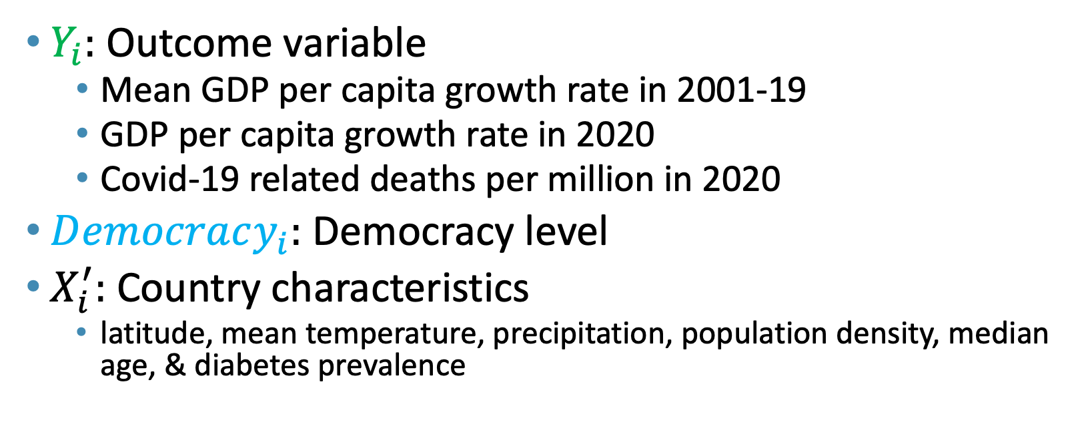
Empirical specification
${ Y}_{i}=μ+αDemocracy_{i}+X_{i}^{′}γ+ε_{i}$
$Y_{i}:$ Outcome variable
Mean GDP per capita growth rate in 2001-19
GDP per capita growth rate in 2020
Covid-19 related deaths per million in 2020
$Democracy_{i}:$ Democracy level
$X_{i}^{′}:$ Country characteristics
latitude, mean temperature, precipitation, population density, median age, & diabetes prevalence
Notes:
Our simple empirical specification is as follows.
On the left hand side of the equation if our outome variable : either the GDP growth rate in 2020 or the Covid-19-related deaths per million in 2020.
Our main explanatory variable is the level of democracy captured by the democracy index by Freedom House.
We also include controls for other country characteristics that could also determine outcomes in 2020. These are latitude,

Slide 14

1 s.d. $↑$ in democracy:
1.4 p.p. $↓$ per year
in GDP per capita in 2001-19
Notes:
This observation is supported by our OLS regression result. This blue line is the fitted OLS regression line that we get with a regression of the democracy index against the GDP growth rate that weights each country by GDP size. The shaded area is the 95% confidence interval.

Slide 15

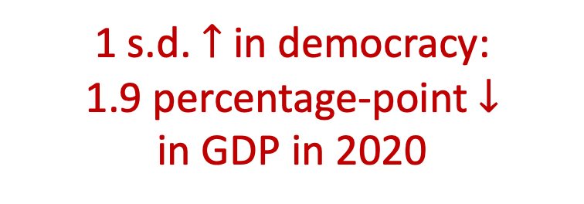
1 s.d. $↑$ in democracy:
1.9 percentage-point $↓$
in GDP in 2020
1 s.d. $↑$ in democracy:
1.9 p.p. $↓$ per year
in GDP per capita in 2020
Notes:
This observation is supported by our OLS regression result. This blue line is the fitted OLS regression line that we get with a regression of the democracy index against the GDP growth rate that weights each country by GDP size. The shaded area is the 95% confidence interval.

Slide 16

1 s.d. $↑$ in democracy:
250 $↑$ Covid-19 related
deaths per million
Notes:
Our OLS regression results, as captured by the blue regresison line, shows that higher levels of democracy correspond to more deaths from Covid-19.

Slide 17
Outline
Data
Democracy is correlated with worse outcomes
Democracy causes the worse outcomes
IVs for political regimes
2SLS estimates
Channels behind democracy’s effect
Conclusion
Notes:
This presentation will proceed as follows:
1. Describe our data on Covid-19 outcomes and democracy
2. Explore the OLS relationship between democracy and Covid-19 outcomes to establish that democracy is significantly associated with worse outcomes.
3. Then, we explain our empirical strategy and describe our five different sets of IVs which we use to identify democracy’s effect.
4. After explaining the empirical strategy, we move on to democracy’s causal effect and the channels behind it.
Then, we conclude.

Slide 18
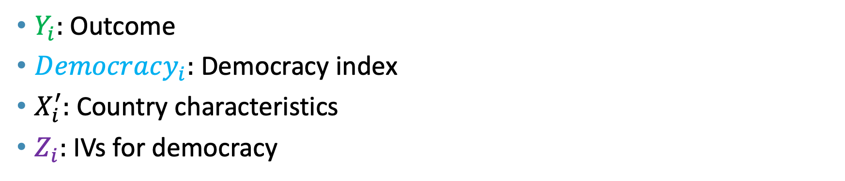
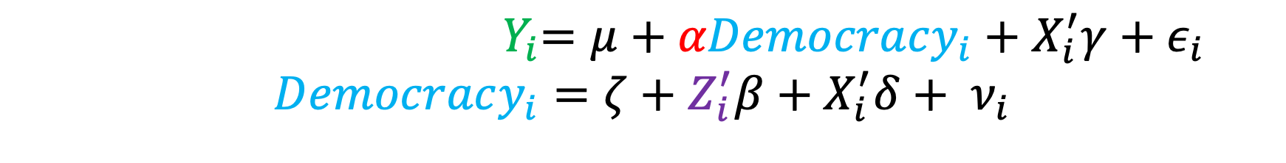
2SLS specification
${ Y}_{i}=μ+αDemocracy_{i}+X_{i}^{′}γ+ε_{i}$
$$Democracy_{i}=ζ+Z_{i}^{′}β+X_{i}^{′}δ+ ν_{i}$$
$Y_{i}:$ Outcome
$Democracy_{i}:$ Democracy index
$X_{i}^{′}:$ Country characteristics
$Z_{i}:$IVs for democracy
Notes:
Our empirical specification is as follows:
The equation at the top, which is our second-stage equation, is the same as our OLS equation, where we have Covid-19 outcomes on the left side, and our main explanatory variable, democracy levels, on the right hand side.
The difference now is that, since democracy is far from randomly assigned, we introduce a first-stage equation that has democracy as the outcome variable and IVs for political regimes, captured by Z, as the main explanatory variable.

Slide 19
IVs for democracy
We adopt 5 IVs based on several centuries of world history
European settler mortality (Acemoglu-Johnson-Robinson 01)
Past population density (AJR 02)
Legal origin (LaPorta-Shleifer-Vishny 98)
% speaking English or European (Hall-Jones 99)
Availability of crops & minerals (Easterly-Levine 03)
Notes:
So what kind of IVs actually exist? In our paper, we adopt five IV strategies that considers several centuries of world history. We use these with the expectation that they work as robustness checks against each other.
Five instrumental variables strategies:
European settler mortality
Fraction speaking English or European, and the Frankel-Romer trade share
Legal origin
Availability of crops and minerals
Past population density
These IVs help identify the effects of political institutions by tracing back their origins to geographical and his- torical determinants such as the feasibility and incentives of colonial powers to invest in institution-building, the origin of the legal institution, and natural resource endowments. Indeed, first-stage regressions show that several of these IVs are significant drivers of the cross-country variation in today’s democracy levels.

Slide 20
1. European settler mortality IV
Mortality rate of European soliders, bishops, and sailors in 17th~19th centuries
Use mainly among former European colonies
European settler mortality
Colonial
institutions
Political
regimes
Notes:
First suggested by Acemoglu, Johnson, and Robinson (2001) as an IV for political and social institutions.
Mortality rate of soldiers, bishops, and sailors stationed in the colonies between the seventeenth and nineteenth centuries.

Slide 21
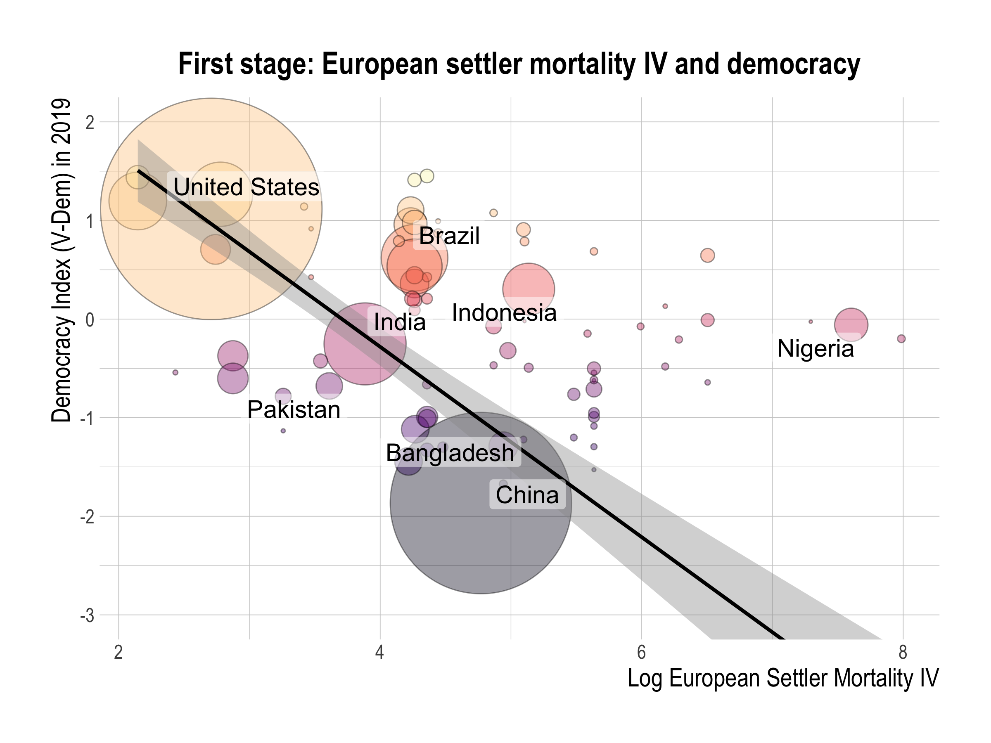

Slide 22
2. Past Population Density
Number of inhabitants per square kilometer in the 16th century
Use mainly among former European colonies
Population
Density in 16th century
Colonial
Institutions
Political
Regimes
Notes:
Our fifth instrumental variable strategy uses past population density, as suggested by Acemoglu, Johnson, and Robinson. This variable records the number of inhabitants per square kilometer in the 16th century.
It works as an instrument because population density at the beginning of the 16th century determined how inclusive or exclusive colonial institutions were.
Sparse populations induced Europeans to settle themselves and develop more inclusive colonial institutions.
On the other hand, more dense local populations meant more slave labor and more wealth to extract, which resulted in more exclusive colonial institutions.
The effect of these colonial institutions persist to the present.

Slide 23
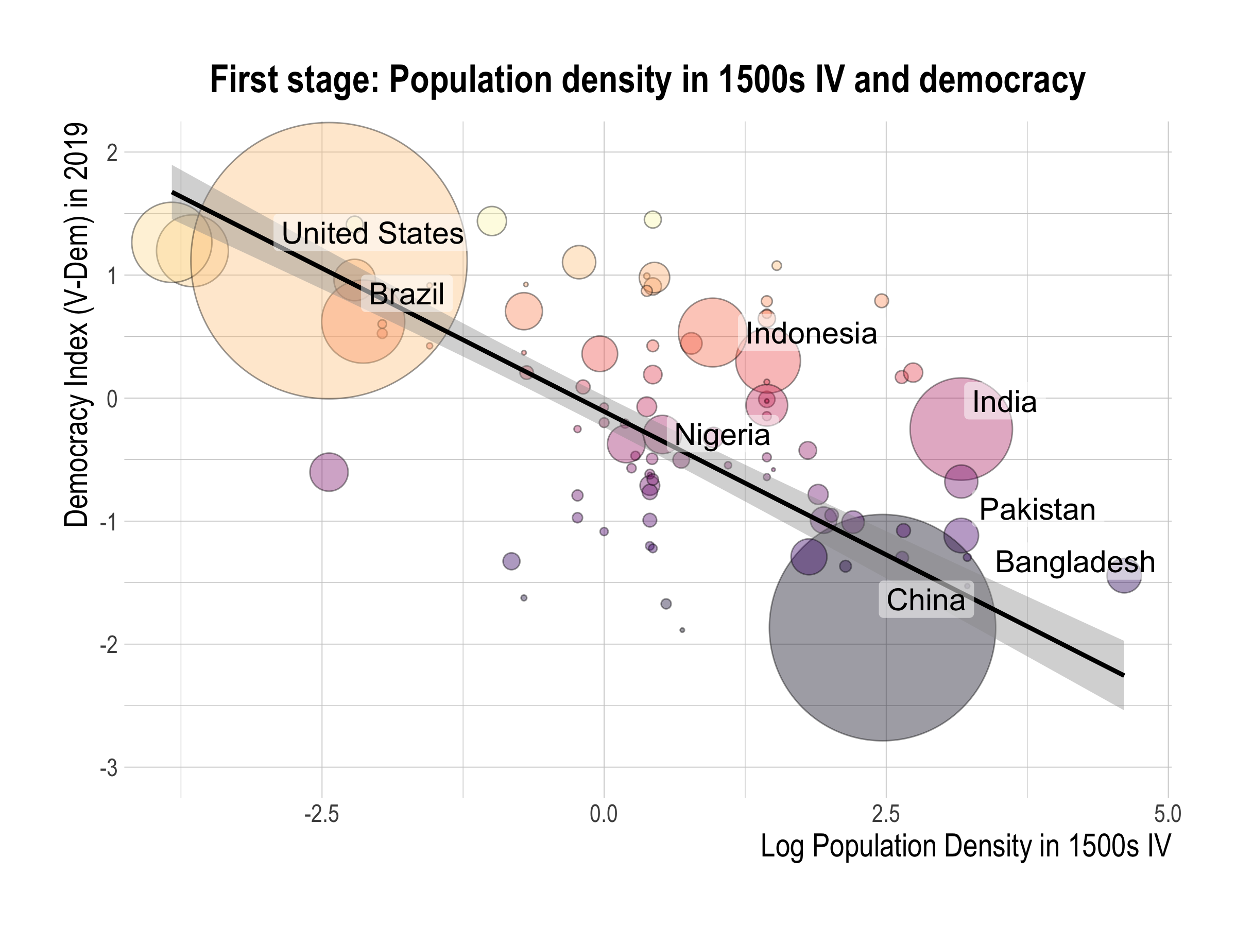

Slide 24
3. Legal Origin
Dummy variable for British legal origin that is coded 1 if the legal origin is British (common-law) & coded 0 if the country’s legal origin is French, German, or Scandinavian (civil law)
Use mainly among former European colonies
Legal
Origin
Legal
Infrastructure
Political
Regimes
Notes:
Our third instrument is legal origin, suggested by LapPorta, Shleifer, and Vishny.
These are dummy variables that are turned on if the country’s legal origin is English, French, or German.
Why are these valid instruments?
Many countries derived their legal systems from colonization by one of these European powers.
Such legal origin determined the general legal infrastructure and influenced how the law protects civil liberties and political rights today, which is significantly correlated with political regimes.
By having separate dummies for legal origin, we allow them to have varying effects on political institutions today.

Slide 25
4. Fraction speaking English or Western European
Fraction of a country’s population speaking English or a major Western European language (French, German, Portuguese, or Spanish) as a mother tongue in 1992
Include all countries in the sample (for which we have data)
Fraction Speaking Western European
Western European
Influence
Political
Regimes
Notes:
Our second instrumental variables strategy uses a set of three instruments proposed by Hall and Jones that consist of the fraction speaking English or European, and the Frankel-Romer trade share.
The fraction speaking English or European is the fraction of a country’s population speaking English or a major Western European language (French, German, Portuguese, or Spanish) as a mother tongue in 1992.
The Frankel-Romer trade share is the predicted share of each country’s economy occupied by international trade, based on the gravity model. Put simply, this gravity model considers a country’s geographic characteristics, such as its distance from neighboring countries to estimate how susceptible a country’s geography is to international trade.
But how are these valid instruments?

Slide 26
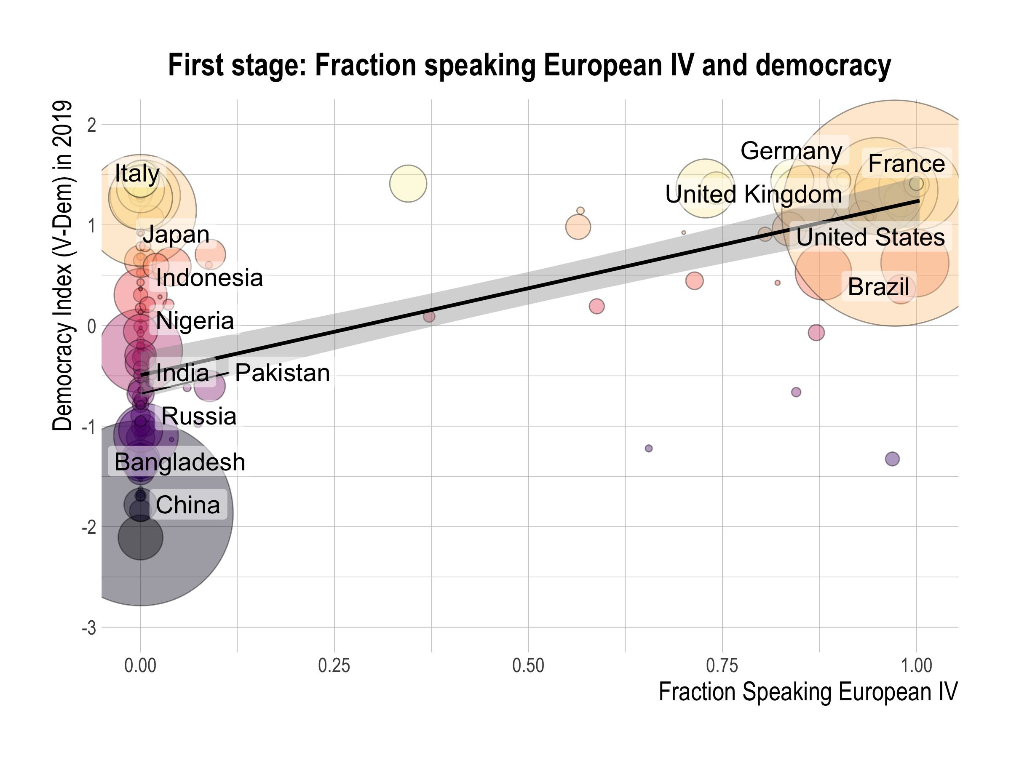

Slide 27
5. Availability of crops & minerals
Dummy variables for whether a country produced or mined a particular commodity in 1990
Bananas, coffee, copper, maize, millet, rice, rubber, silver, sugarcane, wheat
Include all countries in the sample (for which we have data)
Economies
of scale
& slave labor
Crops and minerals
Political
Regimes
Notes:
Our fourth instrument is the availability of crops and minerals, suggested by Easterly and Levine.
These are dummy variables for whether a country produced or mined a particular commodity in 1990.
These commodities are bananas, coffee, maize, millet, rice, rubber, sugarcane, and wheat.
These act as valid instruments because, according to historians such as Engermann and Sokoloff, certain commodities encouraged or discouraged economies of scale and the use of slave labor, which led to more inclusive or extractive institutions that laid the groundwork for today’s political regimes.

Slide 28
Outline
Data
Democracy is correlated with worse outcomes
Democracy causes the worse outcomes
IVs for democracy
2SLS estimates
Channels behind democracy’s effect
Conclusion
Notes:
This presentation will proceed as follows:
1. Describe our data on Covid-19 outcomes and democracy
2. Explore the OLS relationship between democracy and Covid-19 outcomes to establish that democracy is significantly associated with worse outcomes.
3. Then, we explain our empirical strategy and describe our five different sets of IVs which we use to identify democracy’s effect.
4. After explaining the empirical strategy, we move on to democracy’s causal effect and the channels behind it.
Then, we conclude.

Slide 29
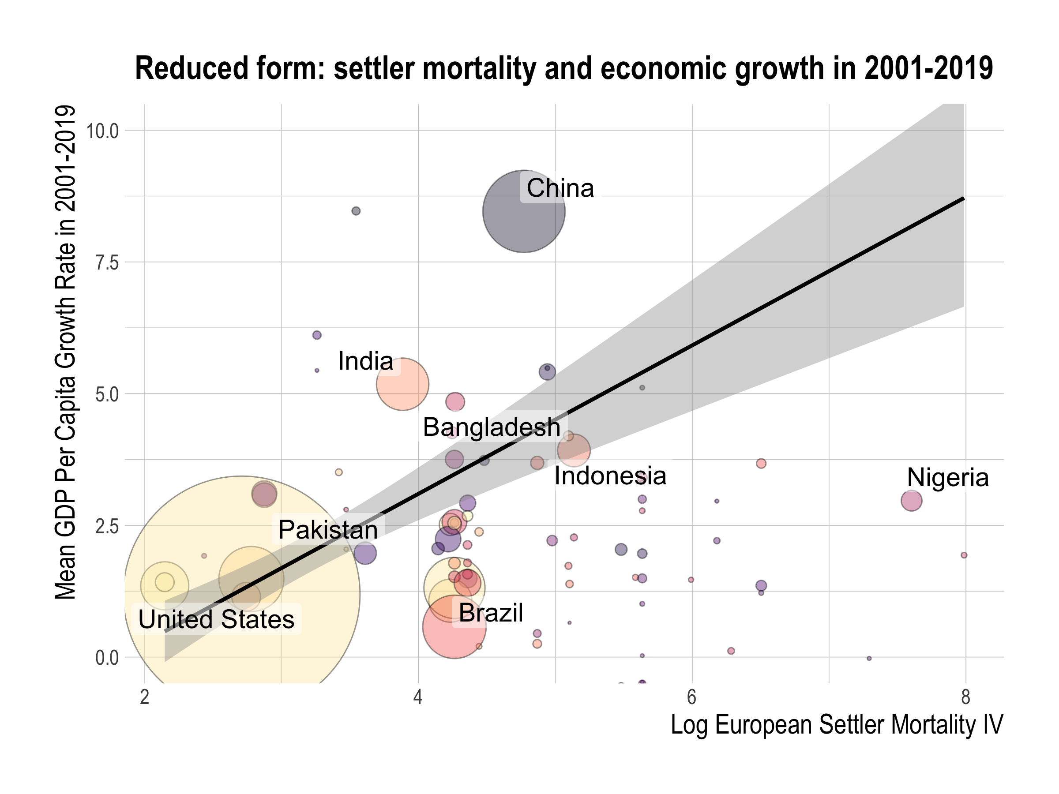

Slide 30
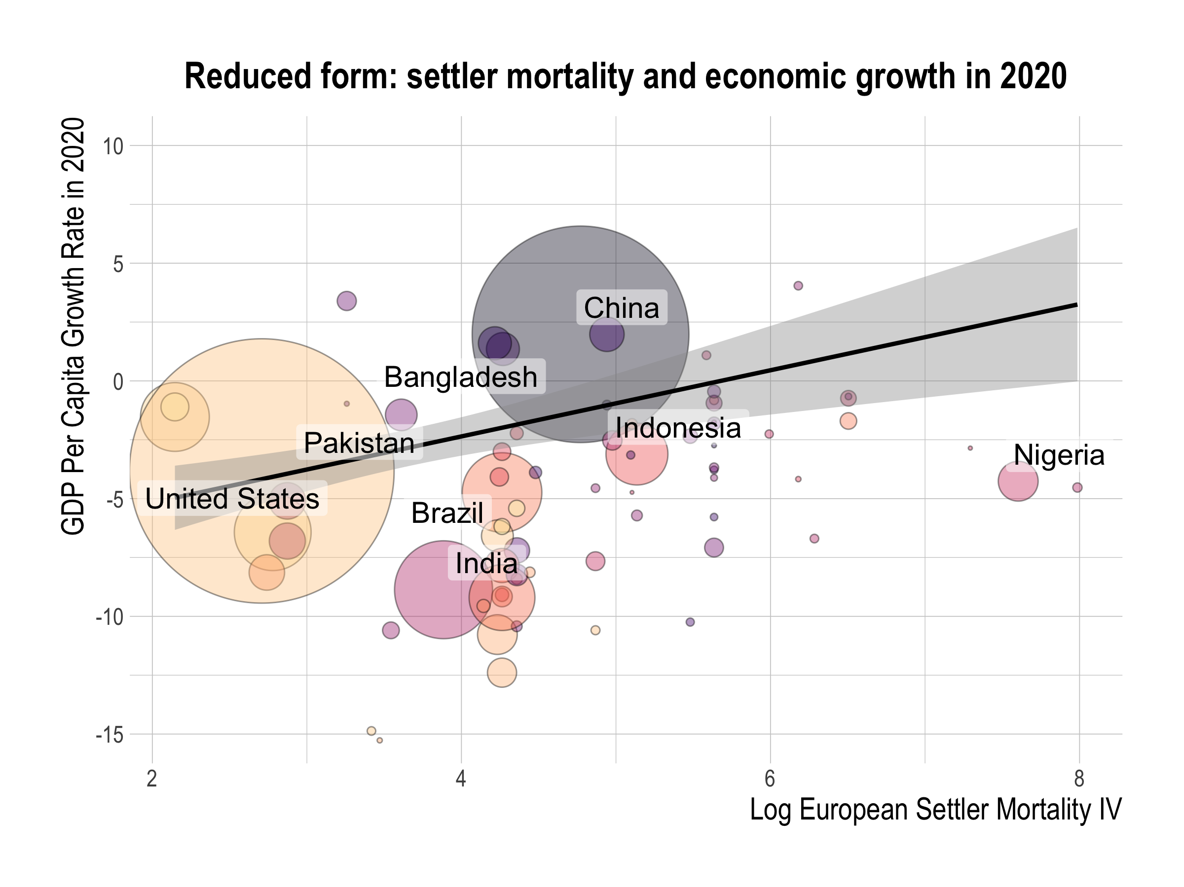

Slide 31
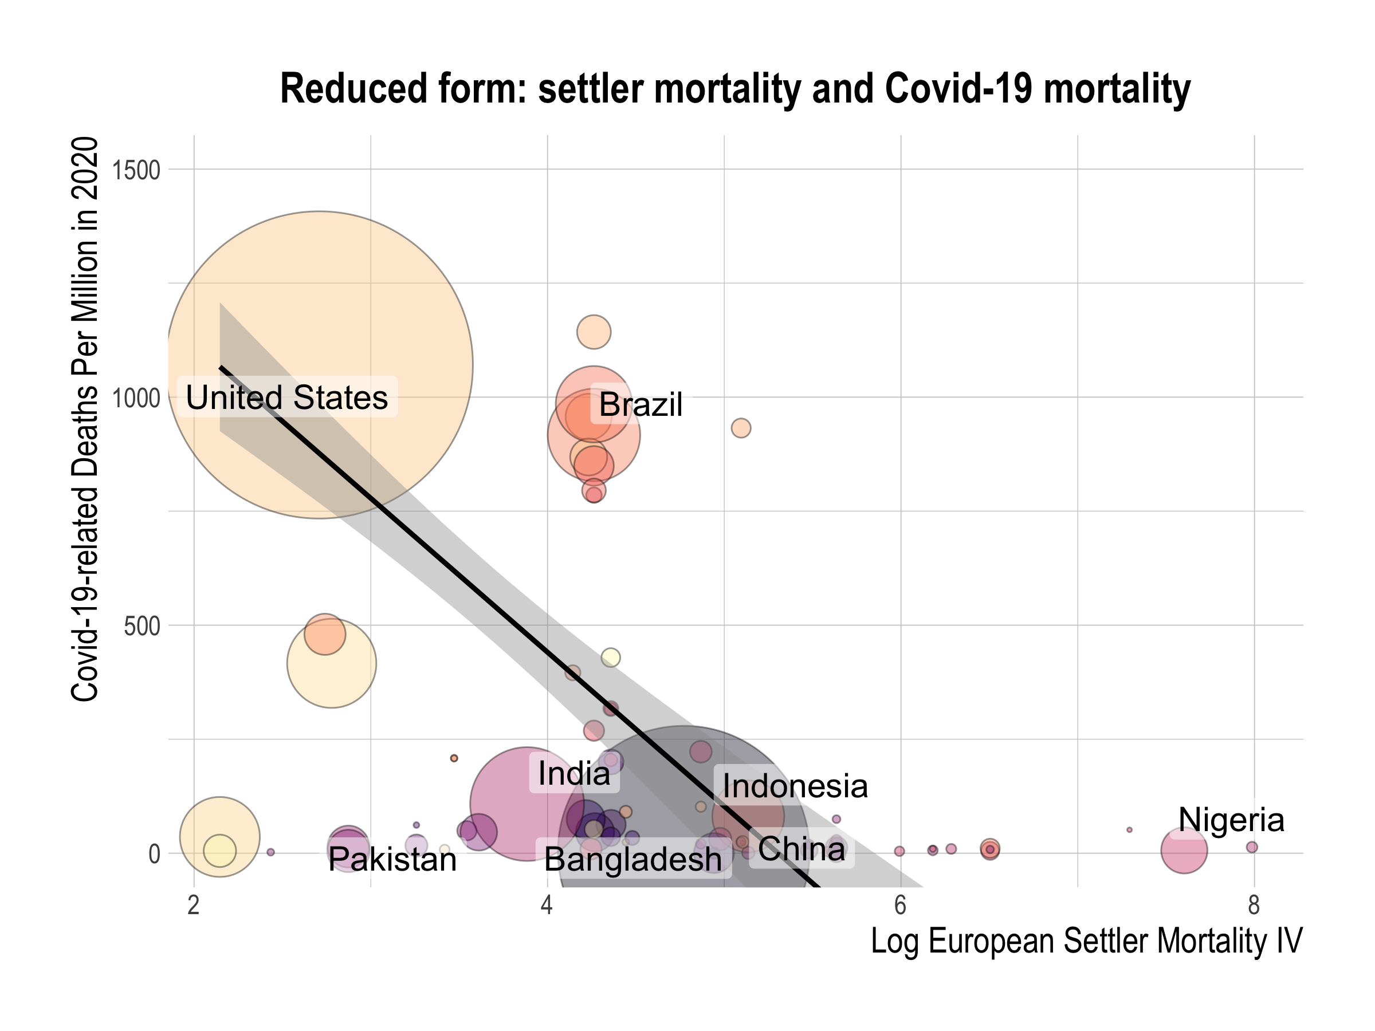

Slide 32
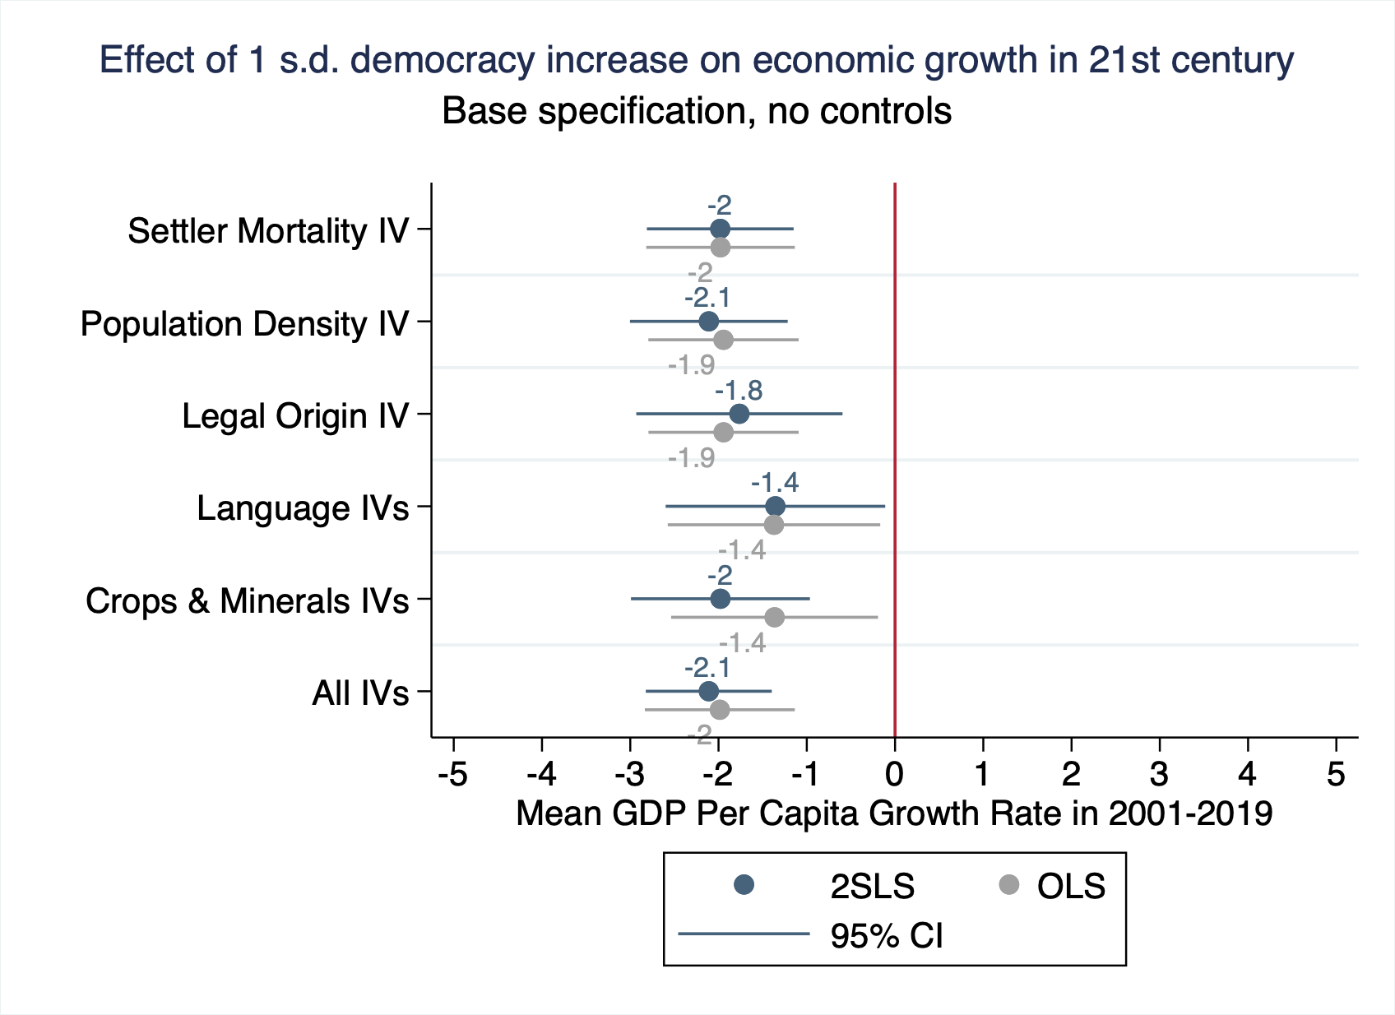
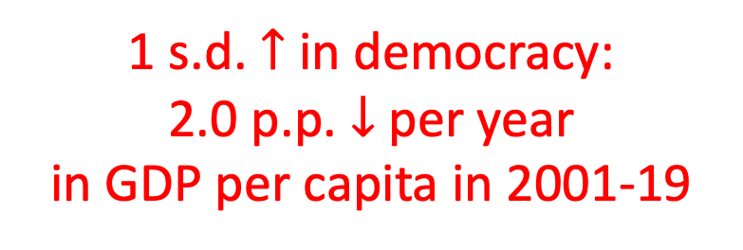
1 s.d. $↑$ in democracy:
2.0 p.p. $↓$ per year
in GDP per capita in 2001-19

Slide 33
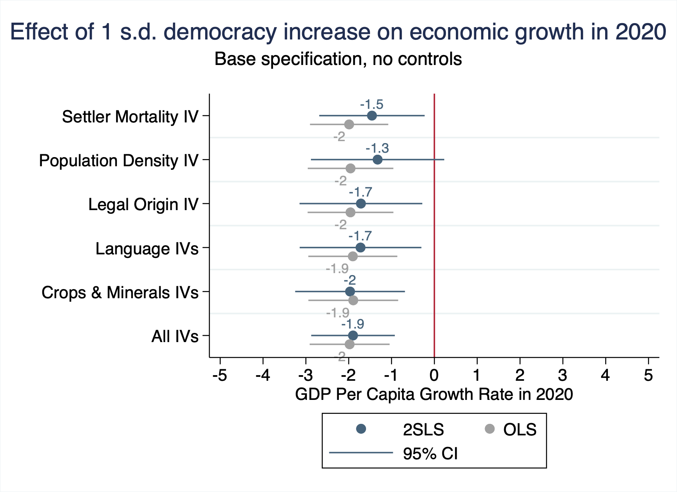
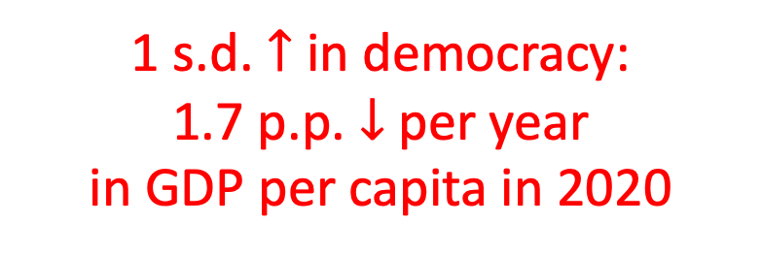
1 s.d. $↑$ in democracy:
1.7 p.p. $↓$ per year
in GDP per capita in 2020

Slide 34
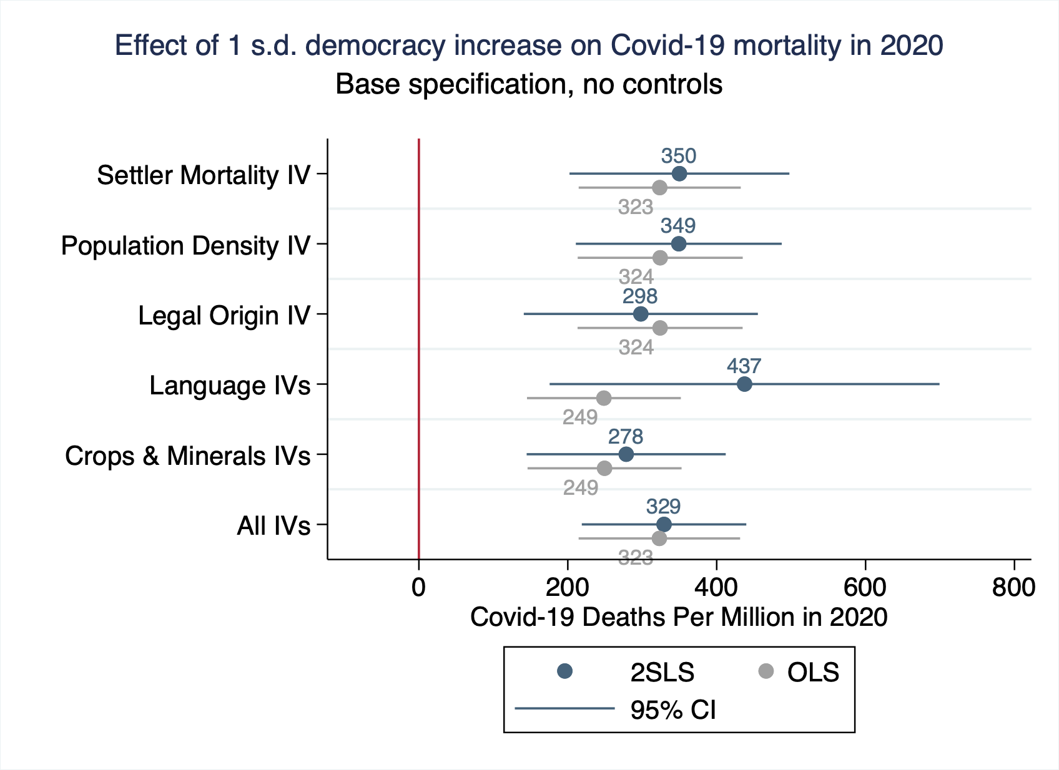
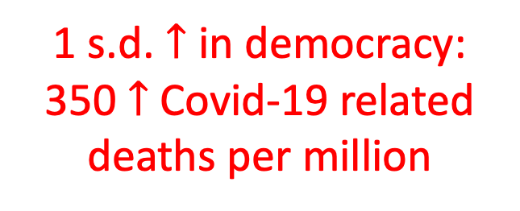
1 s.d. $↑$ in democracy:
350 $↑$ Covid-19 related
deaths per million
Notes:
We also find a significant causal effect of democracy on Covid-19 deaths per million.
We find that a standard deviation increase in democracy levels caused around a 400 increase in Covid-19-related deaths per million.
As we can see, this result is consistent across the give instrumental variable strategies.
Moreover, this result again implies that democracy is a significant determinant of Covid-19 deaths, given that the global average of Covid-19-related deaths per million is 285.

Slide 35
Robustness
Control for country-characteristics
climate (absolute latitude, mean temperature, mean precipitation), population density, population aging & diabetes prevalence
Control for baseline GDP (per capita & total)
Alternative democracy indices
Polity index by the Center for Systemic Peace
Freedom index by Freedom House
Democracy index by the Economist Intelligence Unit
Alternative weightings
no weighting, baseline GDP weighting, population weighting
Alternative sample definitions
exclude G7 countries, exclude US & China, exclude outliers with standardized residual above 1.96 or below -1.96, only G20 countries
Notes:
Although we do not have time to go into detail today, in our paper, we show that our results are robust to various specifications.
The addition of controls such as climate, population density, population ageing, diabetes prevalence, or service sector share, all of which are plausible determinants of Covid-19 outcomes, does not change our baseline results of a negative effect of democracy.
Neither does using alternative democracy indices, or alternative weighting methods, change our results.
We also establish that our result is a global phenomenon and not driven by US and China alone, by showing that we get similar results even when excluding the US and China from the sample.

Slide 36
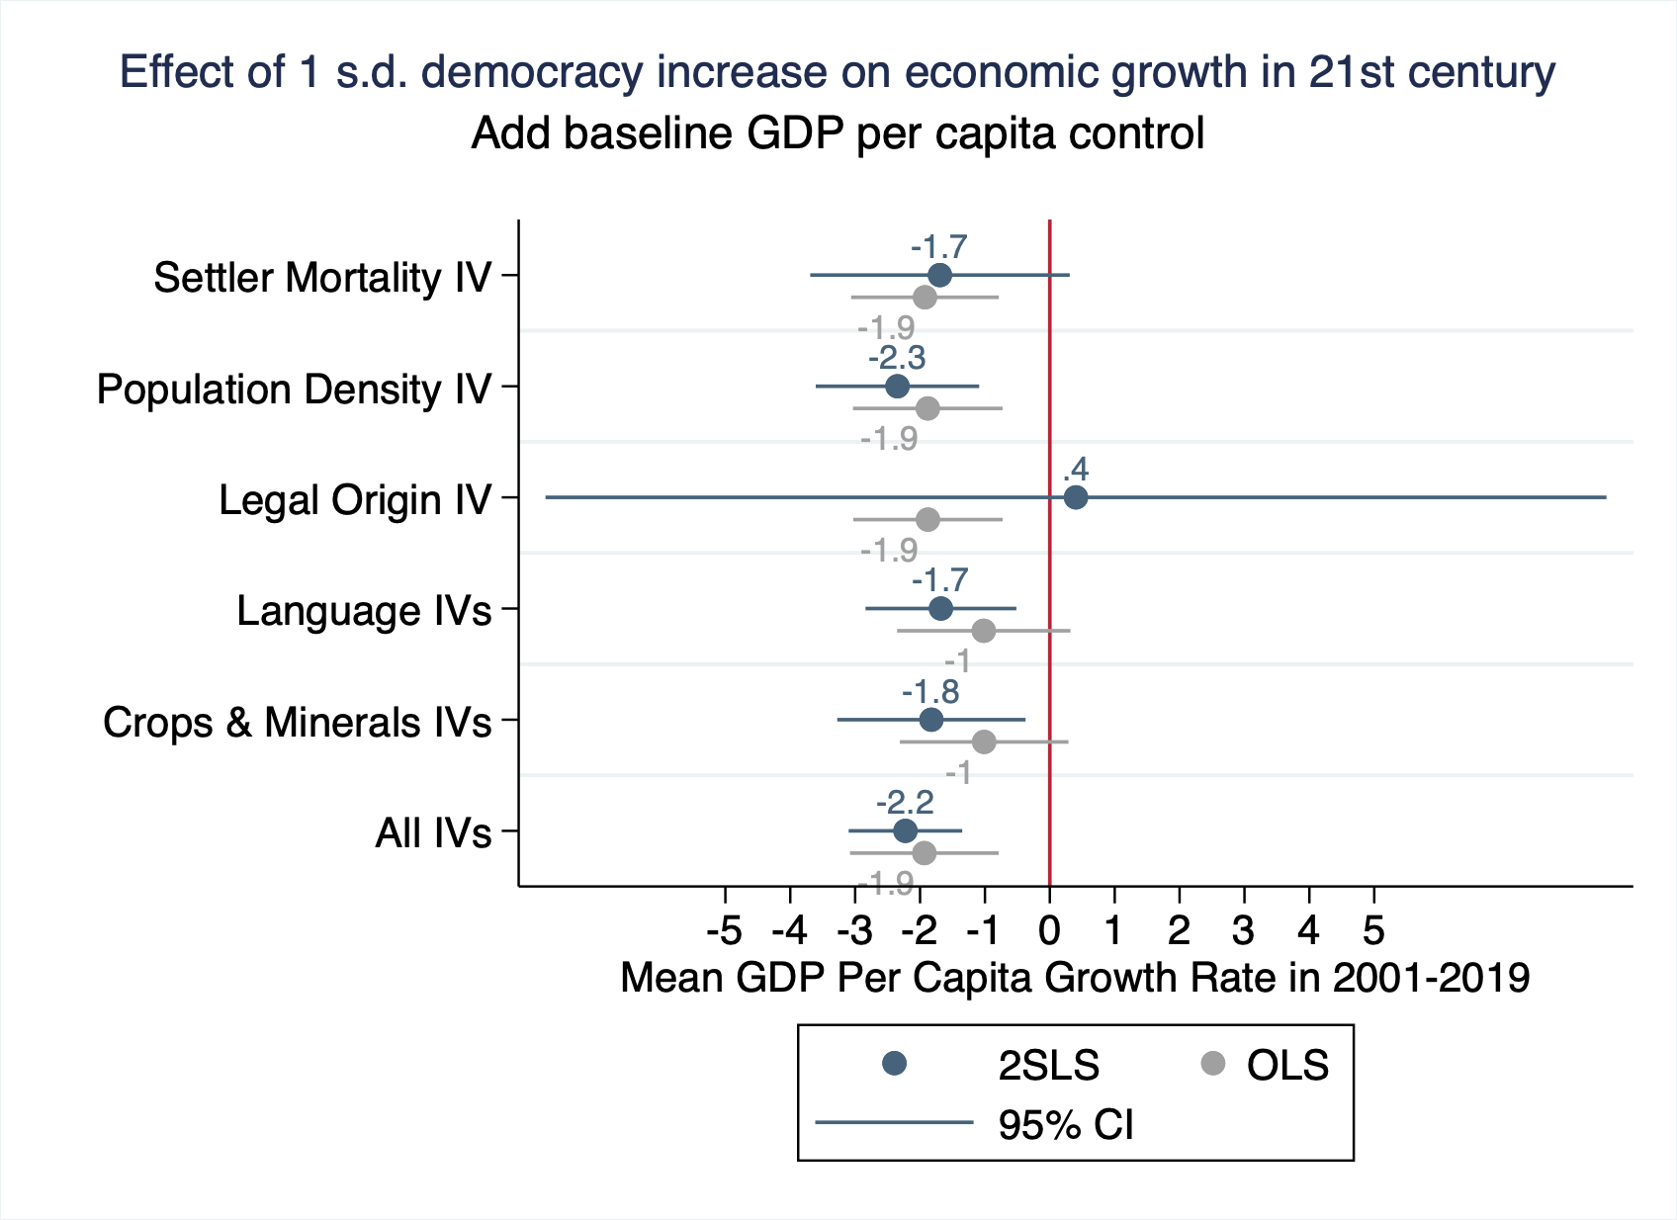

Slide 37
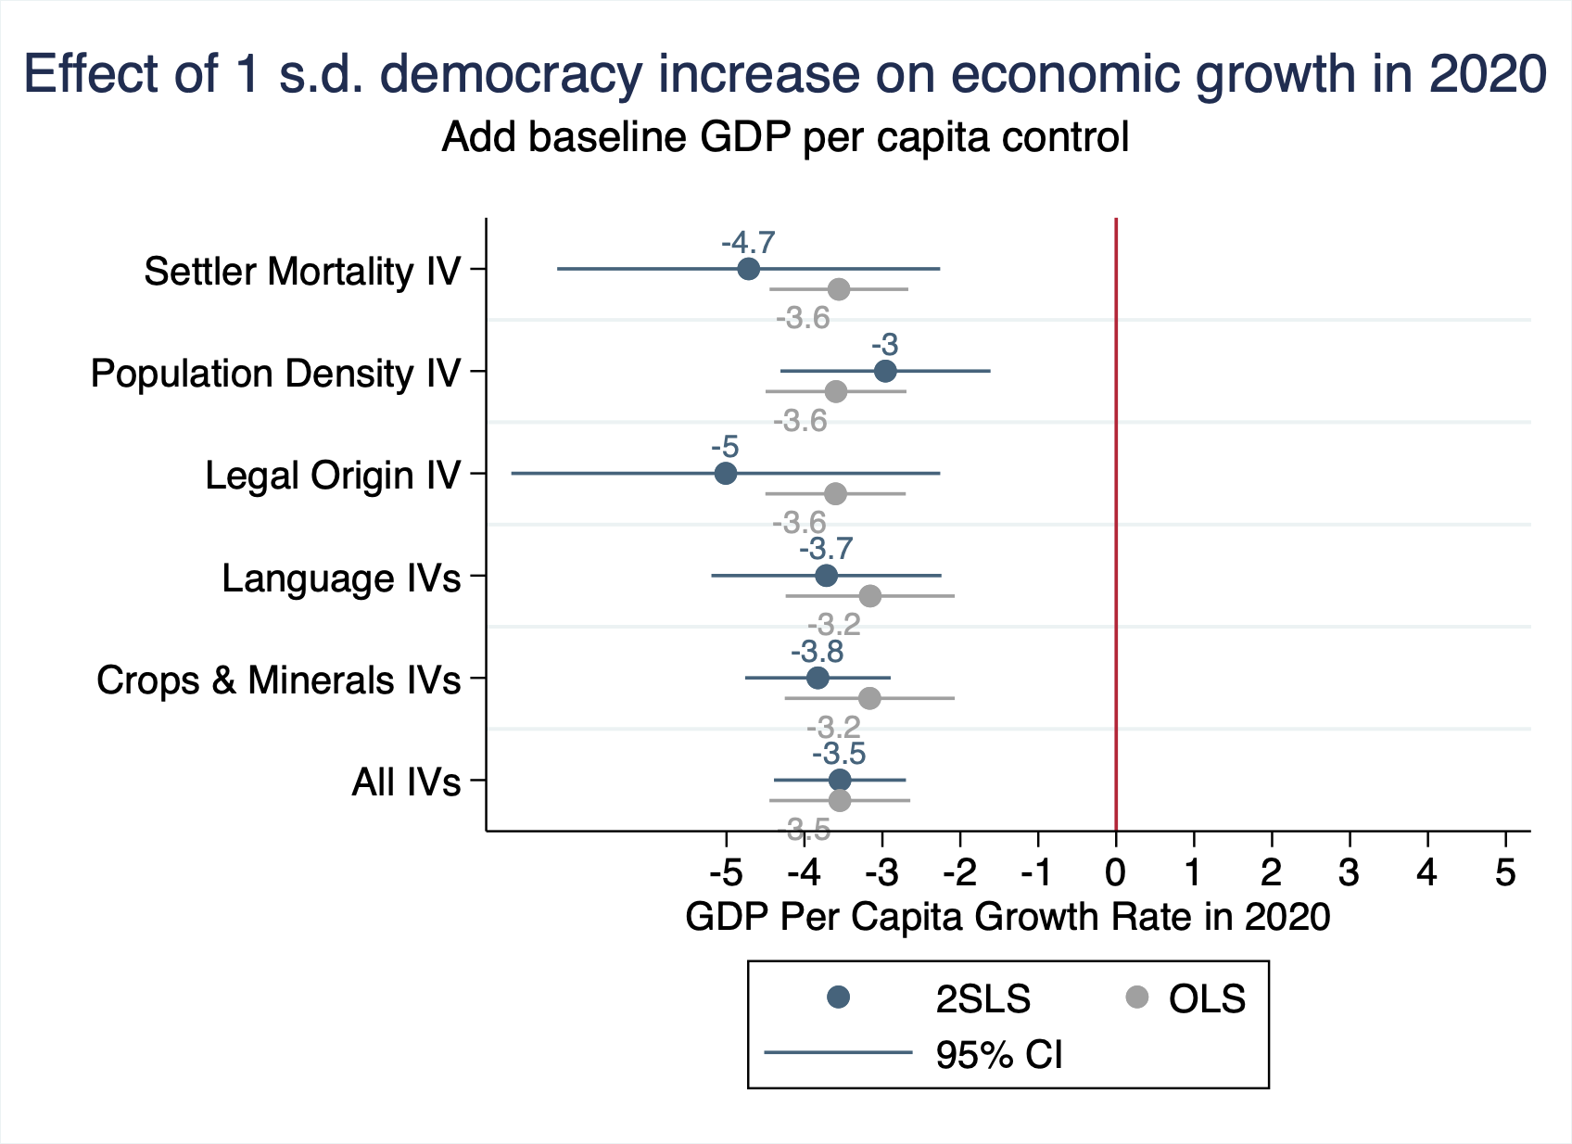

Slide 38
Outline
Data
Democracy is correlated with worse outcomes
Democracy causes the worse outcomes
IVs for political regimes
2SLS estimates
Channels behind democracy’s effect
Conclusion
Notes:
This presentation will proceed as follows:
1. Describe our data on Covid-19 outcomes and democracy
2. Explore the OLS relationship between democracy and Covid-19 outcomes to establish that democracy is significantly associated with worse outcomes.
3. Then, we explain our empirical strategy and describe our five different sets of IVs which we use to identify democracy’s effect.
4. After explaining the empirical strategy, we move on to democracy’s causal effect and the channels behind it.
Then, we conclude.

Slide 39
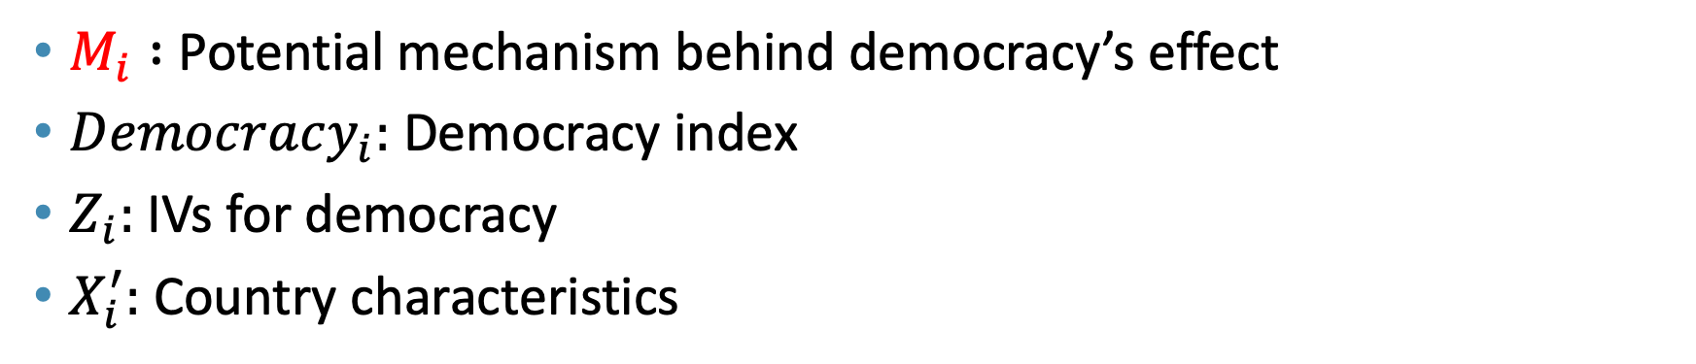
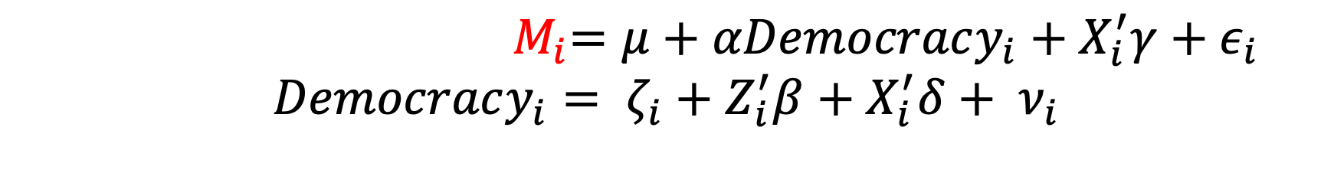
2SLS specification
${ M}_{i}=μ+αDemocracy_{i}+X_{i}^{′}γ+ε_{i}$
$$Democracy_{i}= ζ_{i}+Z_{i}^{′}β+X_{i}^{′}δ+ ν_{i}$$
$M_{i} :$ Potential mechanism behind democracy’s effect
$Democracy_{i}:$ Democracy index
$Z_{i}:$IVs for democracy
$X_{i}^{′}:$ Country characteristics
Notes:
To explore this empirically, we use the following familiar specification, where we replace our outcome variable Y with M, whichrepresents the potential mechanism behind democracy’s effect.
////Our empirical specification is as follows:
The equation at the top, which is our second-stage equation, is the same as our OLS equation, where we have Covid-19 outcomes on the left side, and our main explanatory variable, democracy levels, on the right hand side.
The difference now is that, since democracy is far from randomly assigned, we introduce a first-stage equation that has democracy as the outcome variable and instruments for political regimes, captured by Z, as the main explanatory variable.

Slide 40
Potential Mechanisms
Mechanisms that turned out to be important:
Value added in manufacturing and services
Investments
International trade
→ We find a significant negative causal effect in each of these aspects
Less important:
TFP
primary/secondary school enrollment
child mortality rates
taxes as a share of GDP
domestic conflict
R&D expenditure/researchers
# of new businesses

Slide 41
Value Added in Manufacturing and Services
Definitions:
Manufacturing sector: industries that physically or chemically transform materials into new products
Service sector: any services, for example wholesale and retail trade, transport, education, healthcare, and finance
Value Added: net output of a sector after adding up all output and subtracting intermediate inputs
Look at the annual growth rate in value added in 2001-2019
Source: World Bank, National Accounts Data

Slide 42
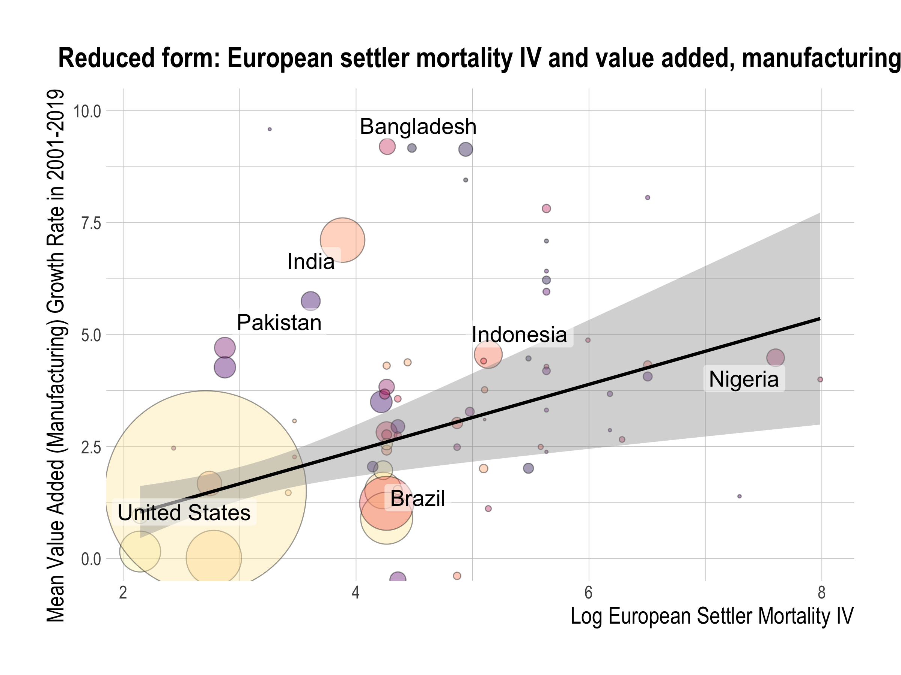

Slide 43
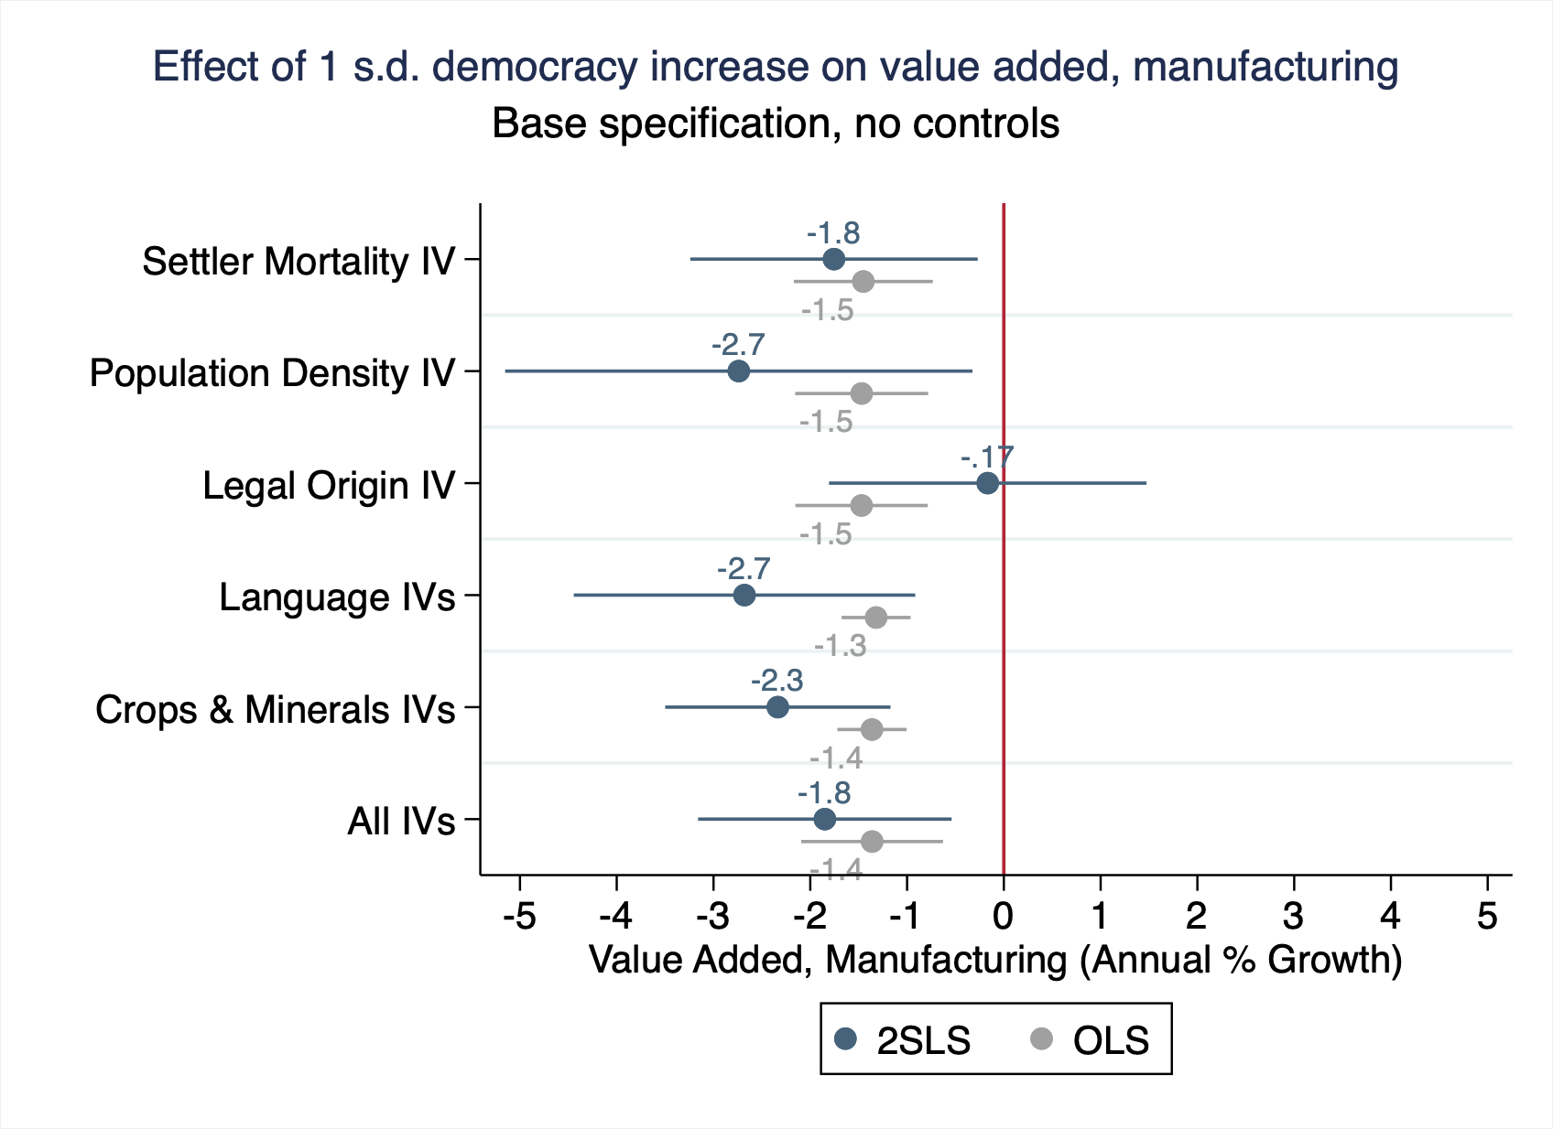
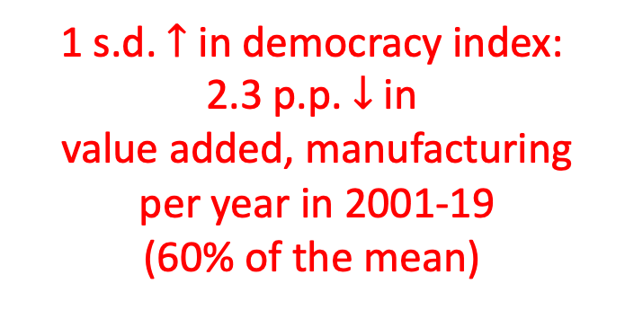
1 s.d. $↑$ in democracy index:
2.3 p.p. $↓$ in
value added, manufacturing
per year in 2001-19
(60% of the mean)

Slide 44
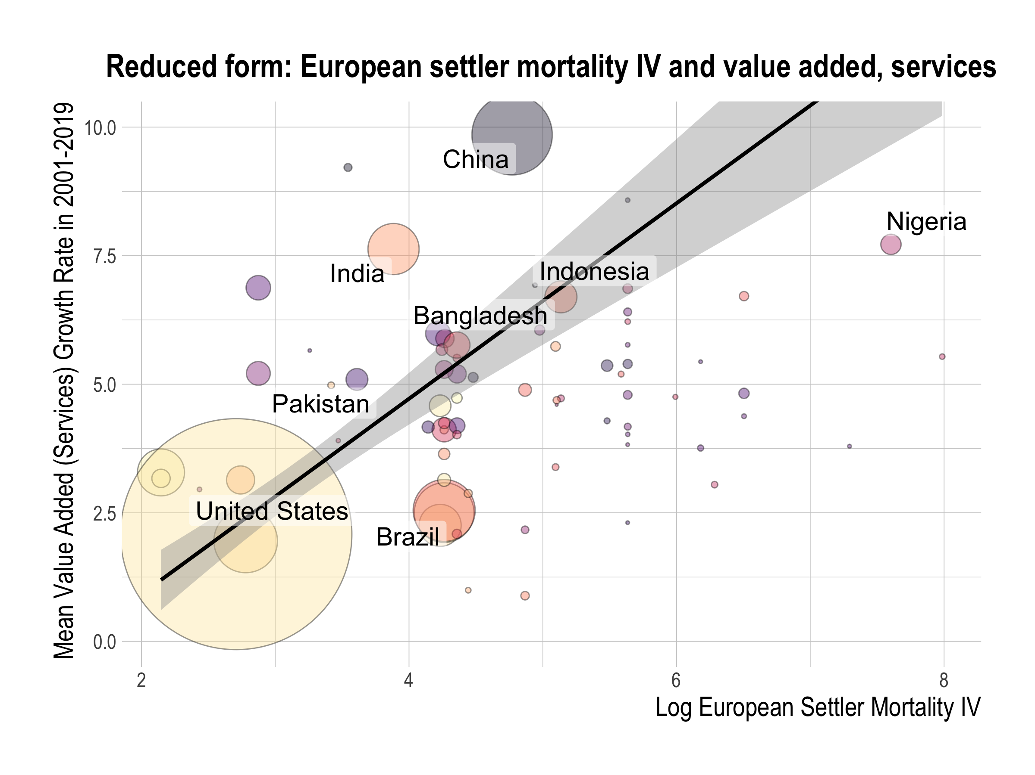

Slide 45
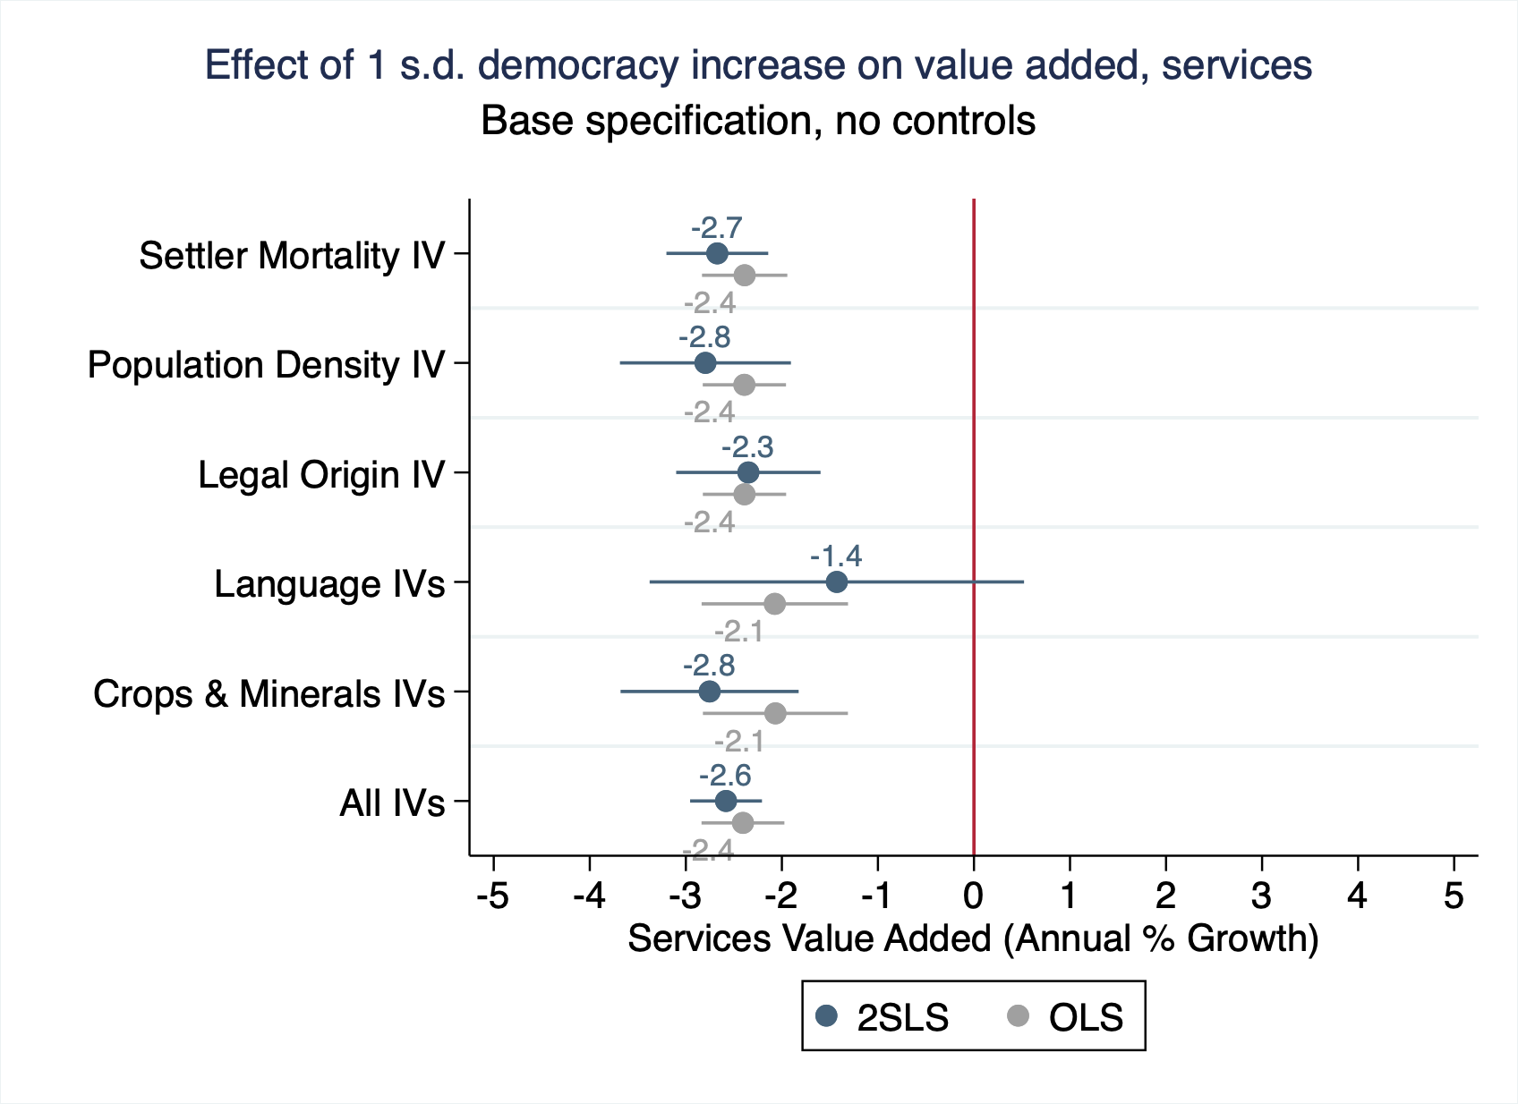
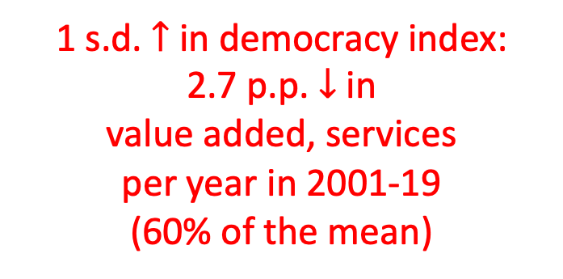
1 s.d. $↑$ in democracy index:
2.7 p.p. $↓$ in
value added, services
per year in 2001-19
(60% of the mean)

Slide 46
Investment as a share of GDP
Definition:
Investment: the total value of the gross fixed capital formation and changes in inventories and acquisitions less of disposals of valuables for a unit or sector
Source: IMF’s World Economic Outlook

Slide 47
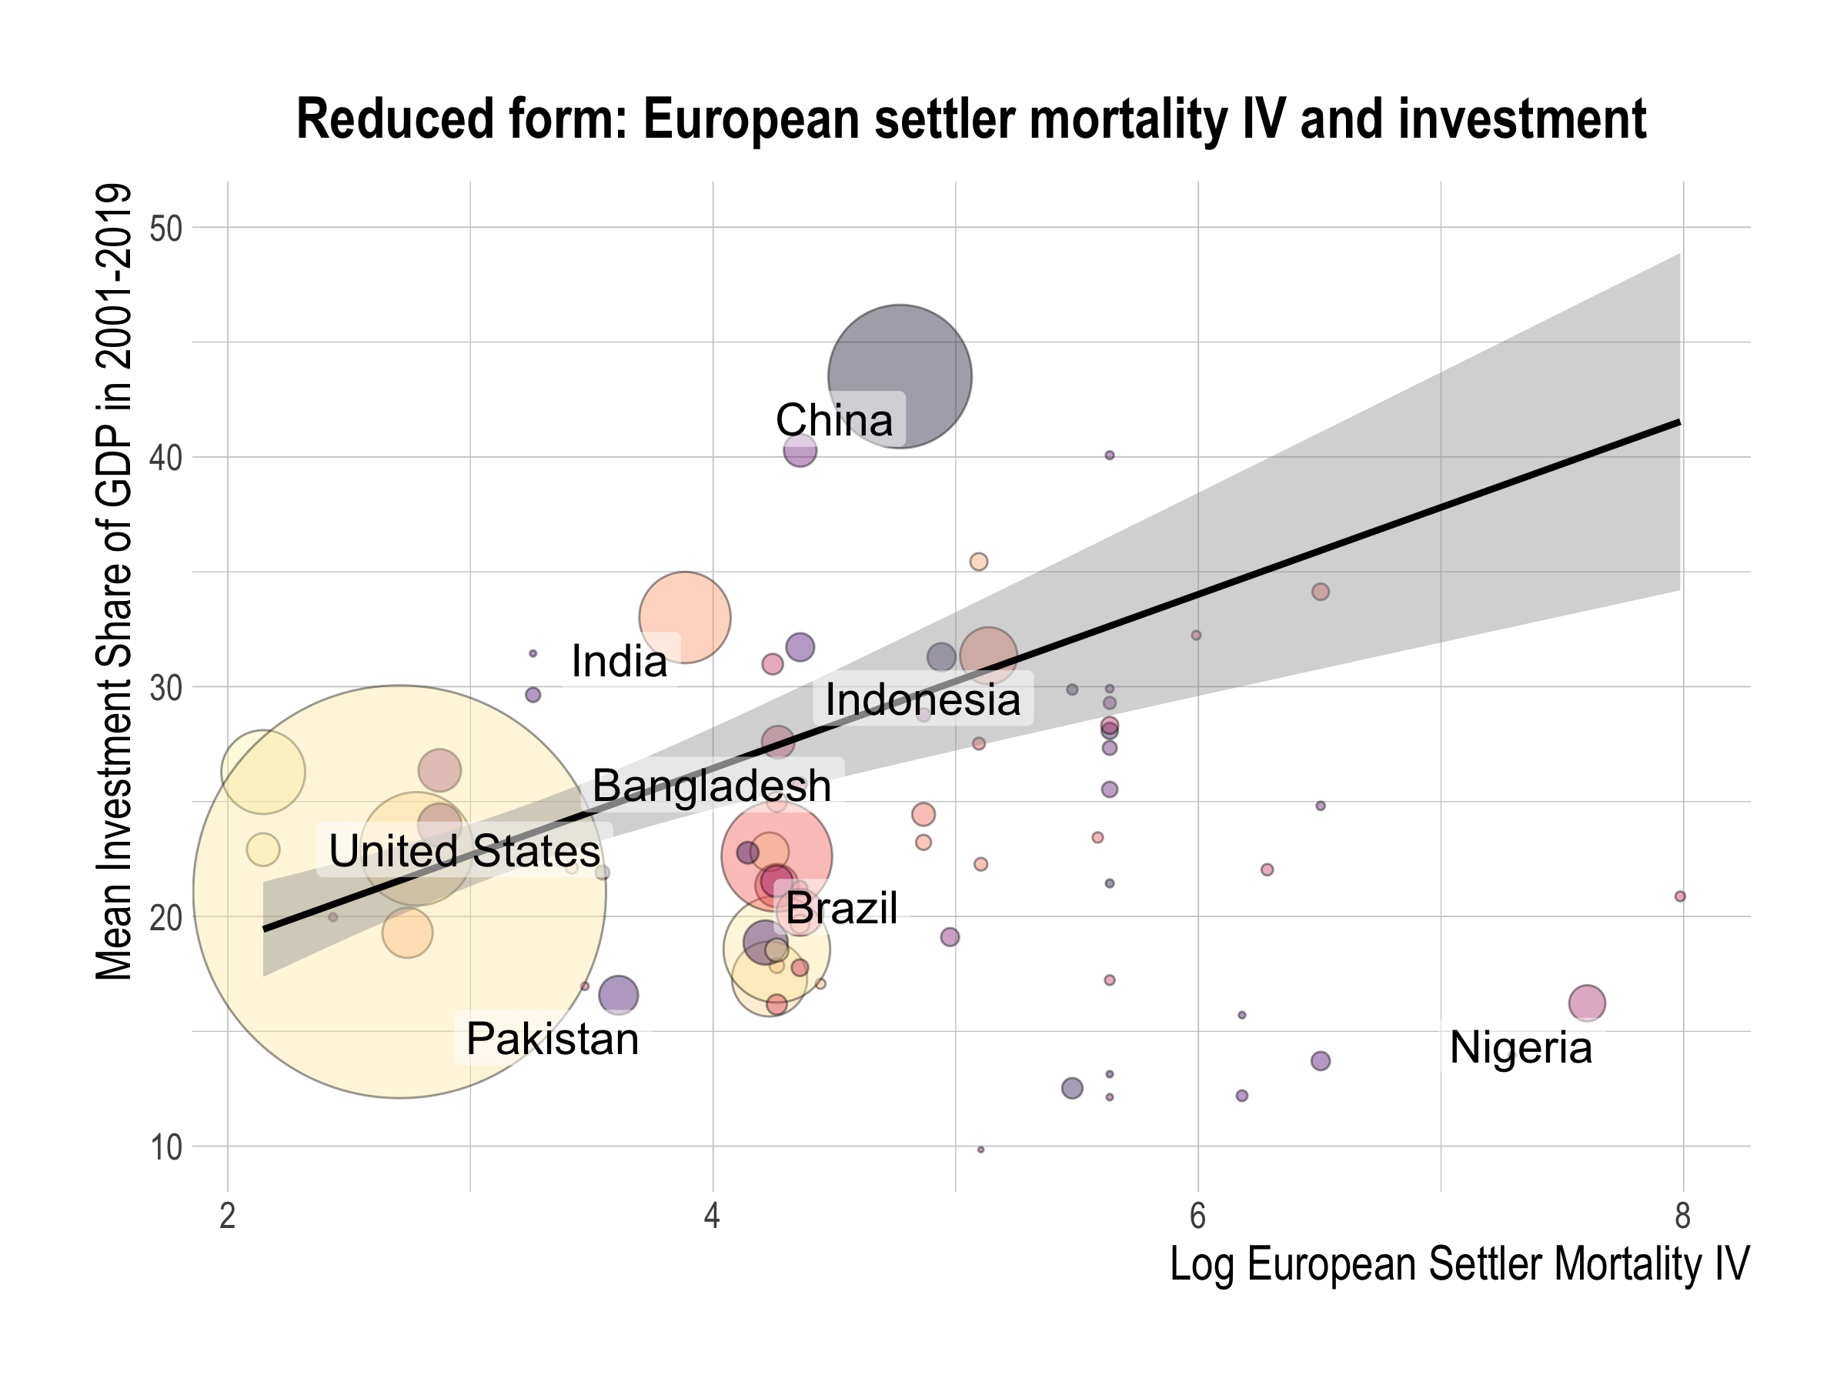

Slide 48
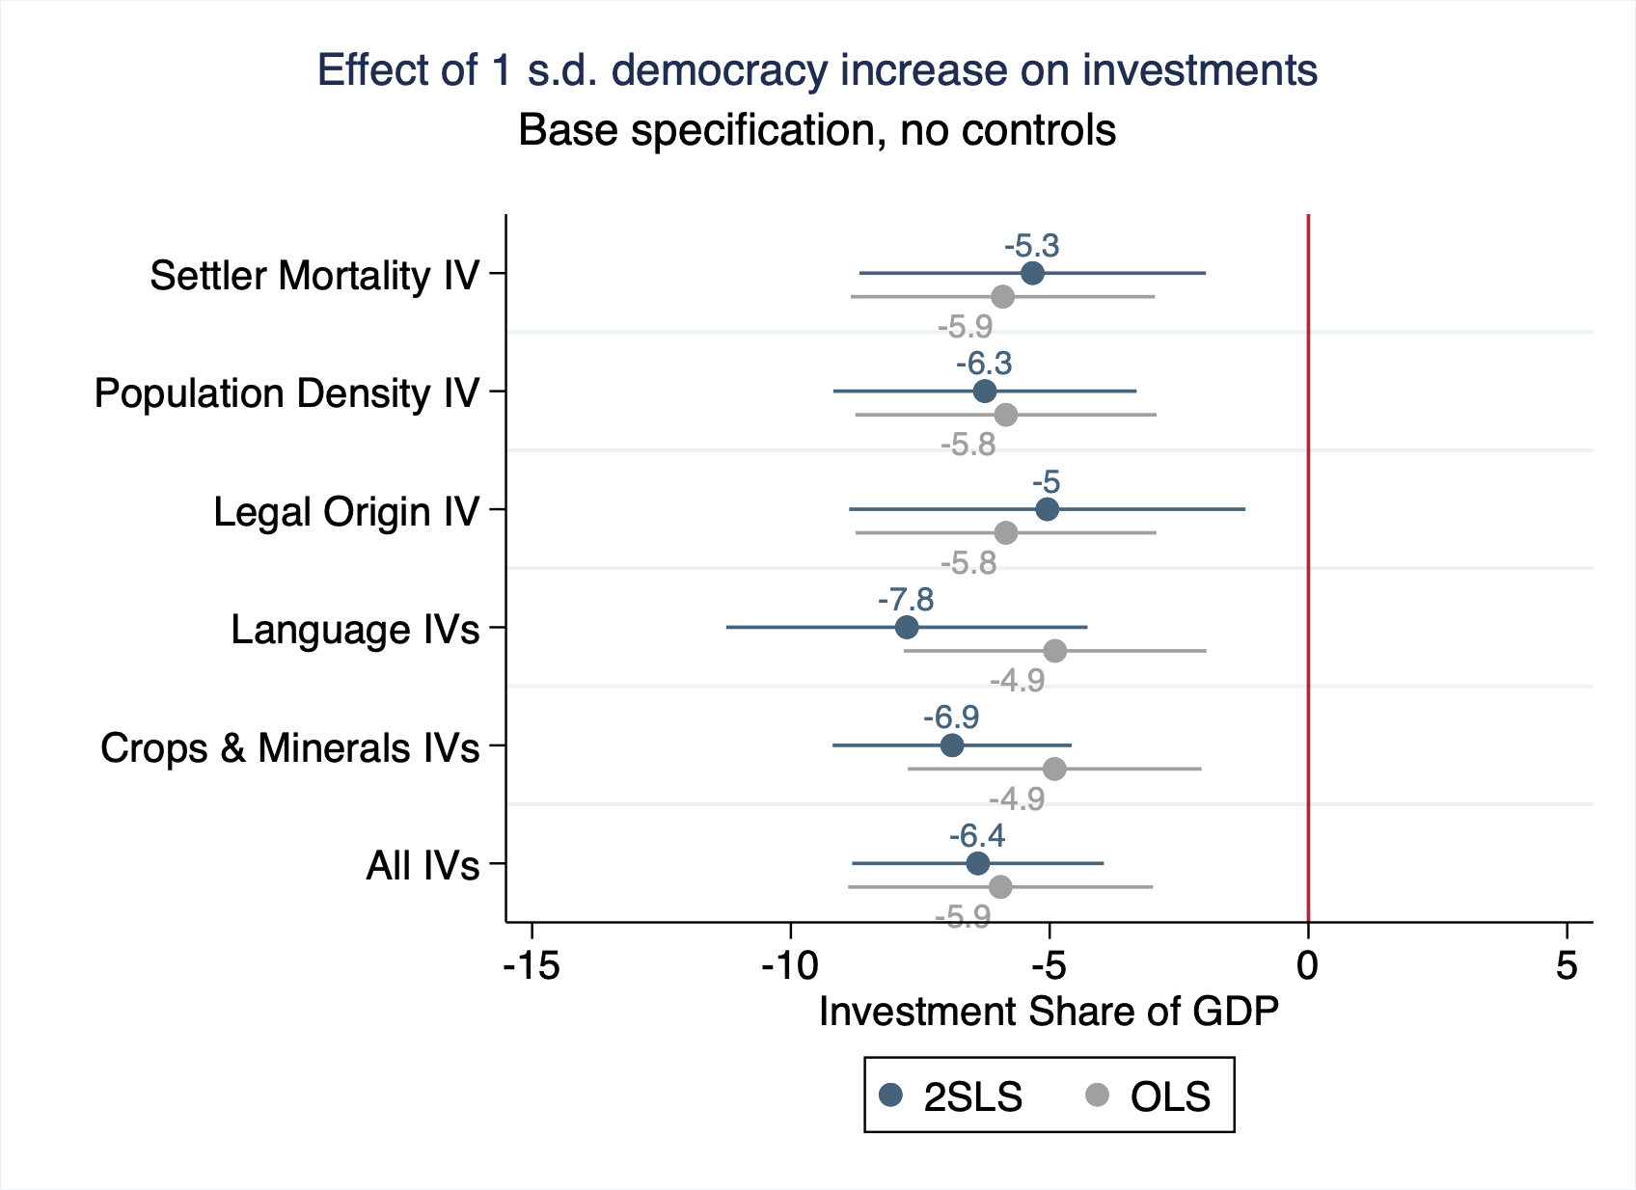
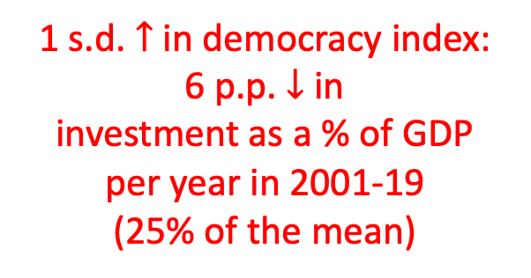
1 s.d. $↑$ in democracy index:
6 p.p. $↓$ in investment as a % of GDP per year in 2001-19
(25% of the mean)

Slide 49
TFP Growth Rate
Definition:
TFP: the ratio of aggregate outputs to aggregate inputs calculated using real GDP, factor input growth rates and factor input shares
Source: Penn World Tables

Slide 50
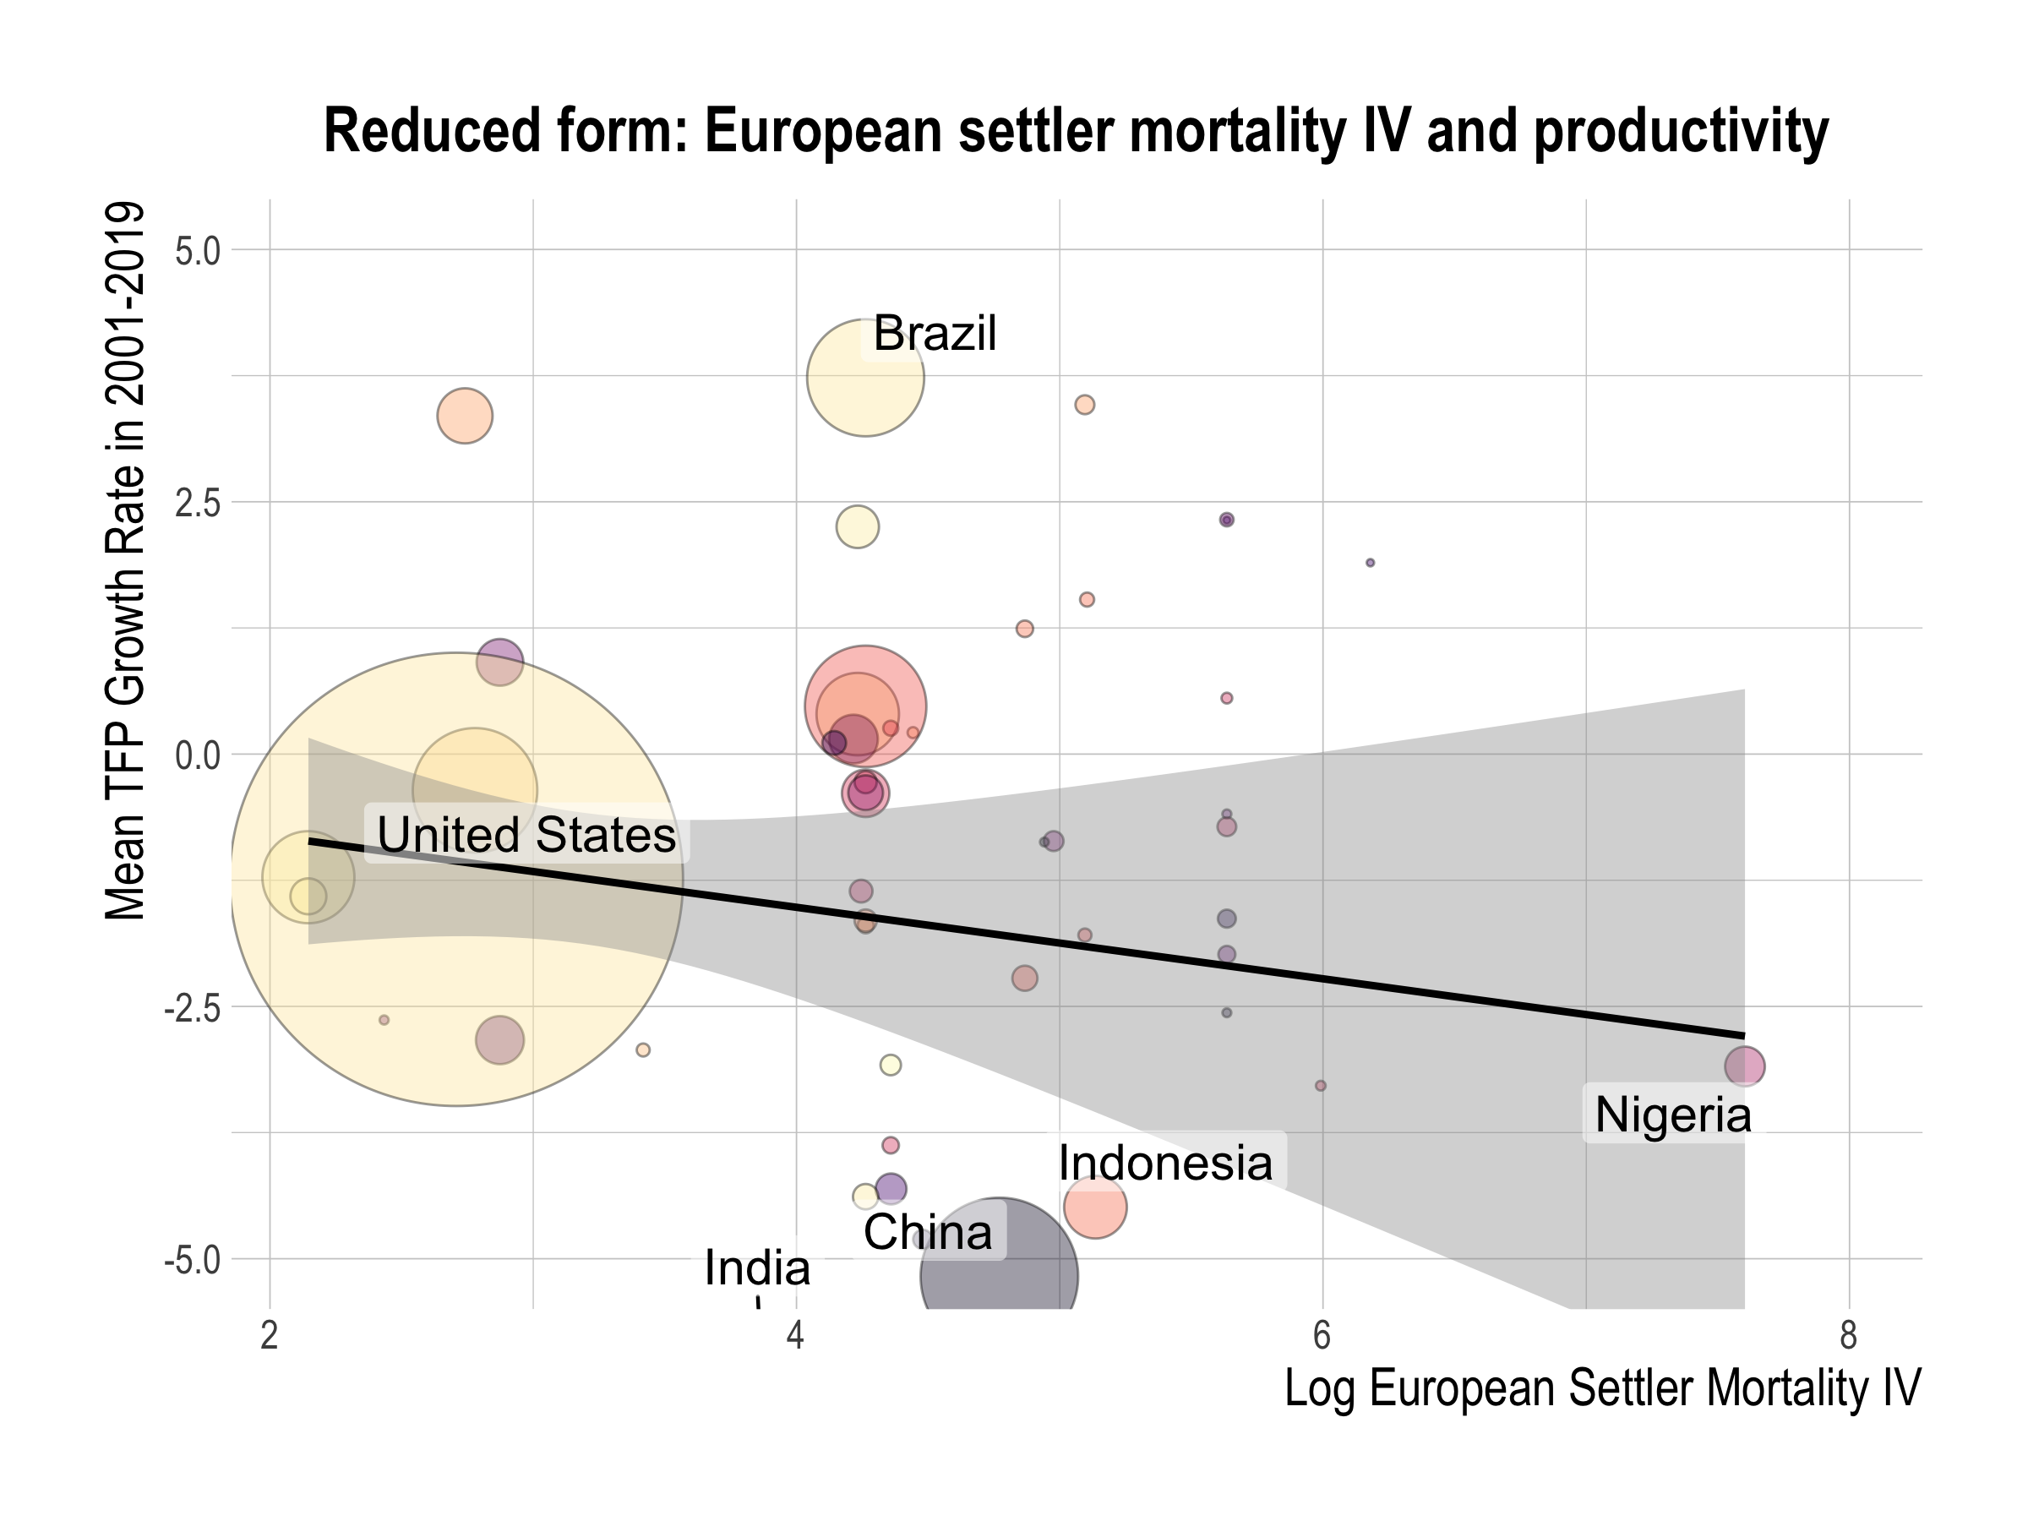

Slide 51
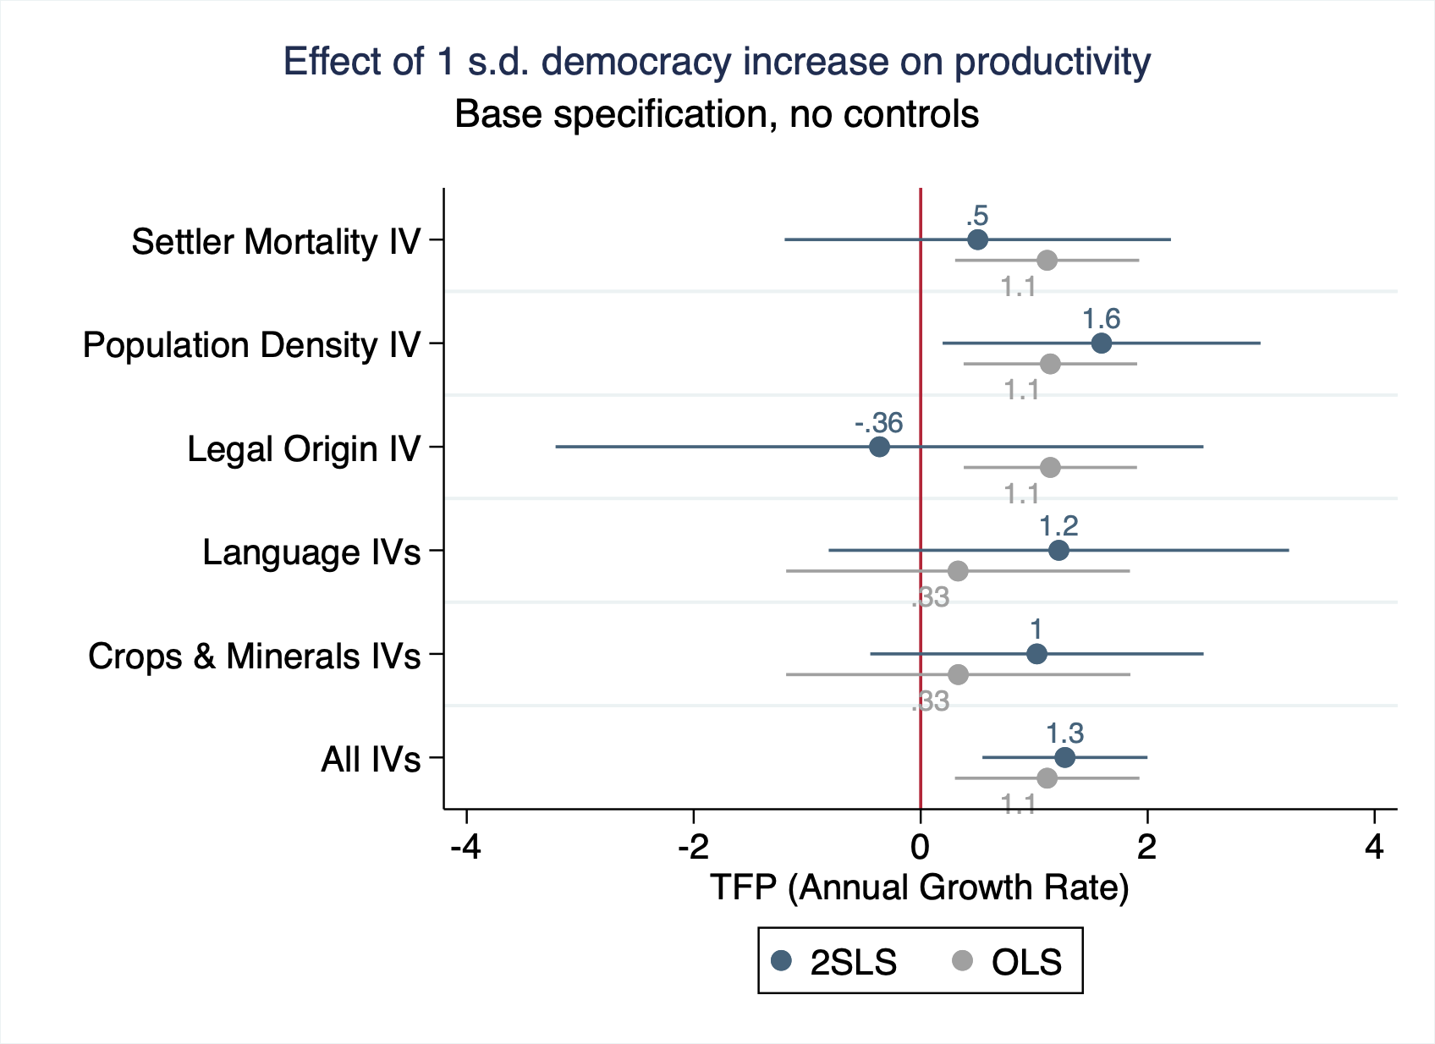
Positive or null effect
of democracy on TFP

Slide 52
Trade
Definitions:
Import value index & export value index: Current value of imports or exports converted to US dollars and expressed as a % of that in the base period (2000)
Source: UN Conference on Trade & Development (UNCTAD), Handbook of Statistics & Data Files

Slide 53
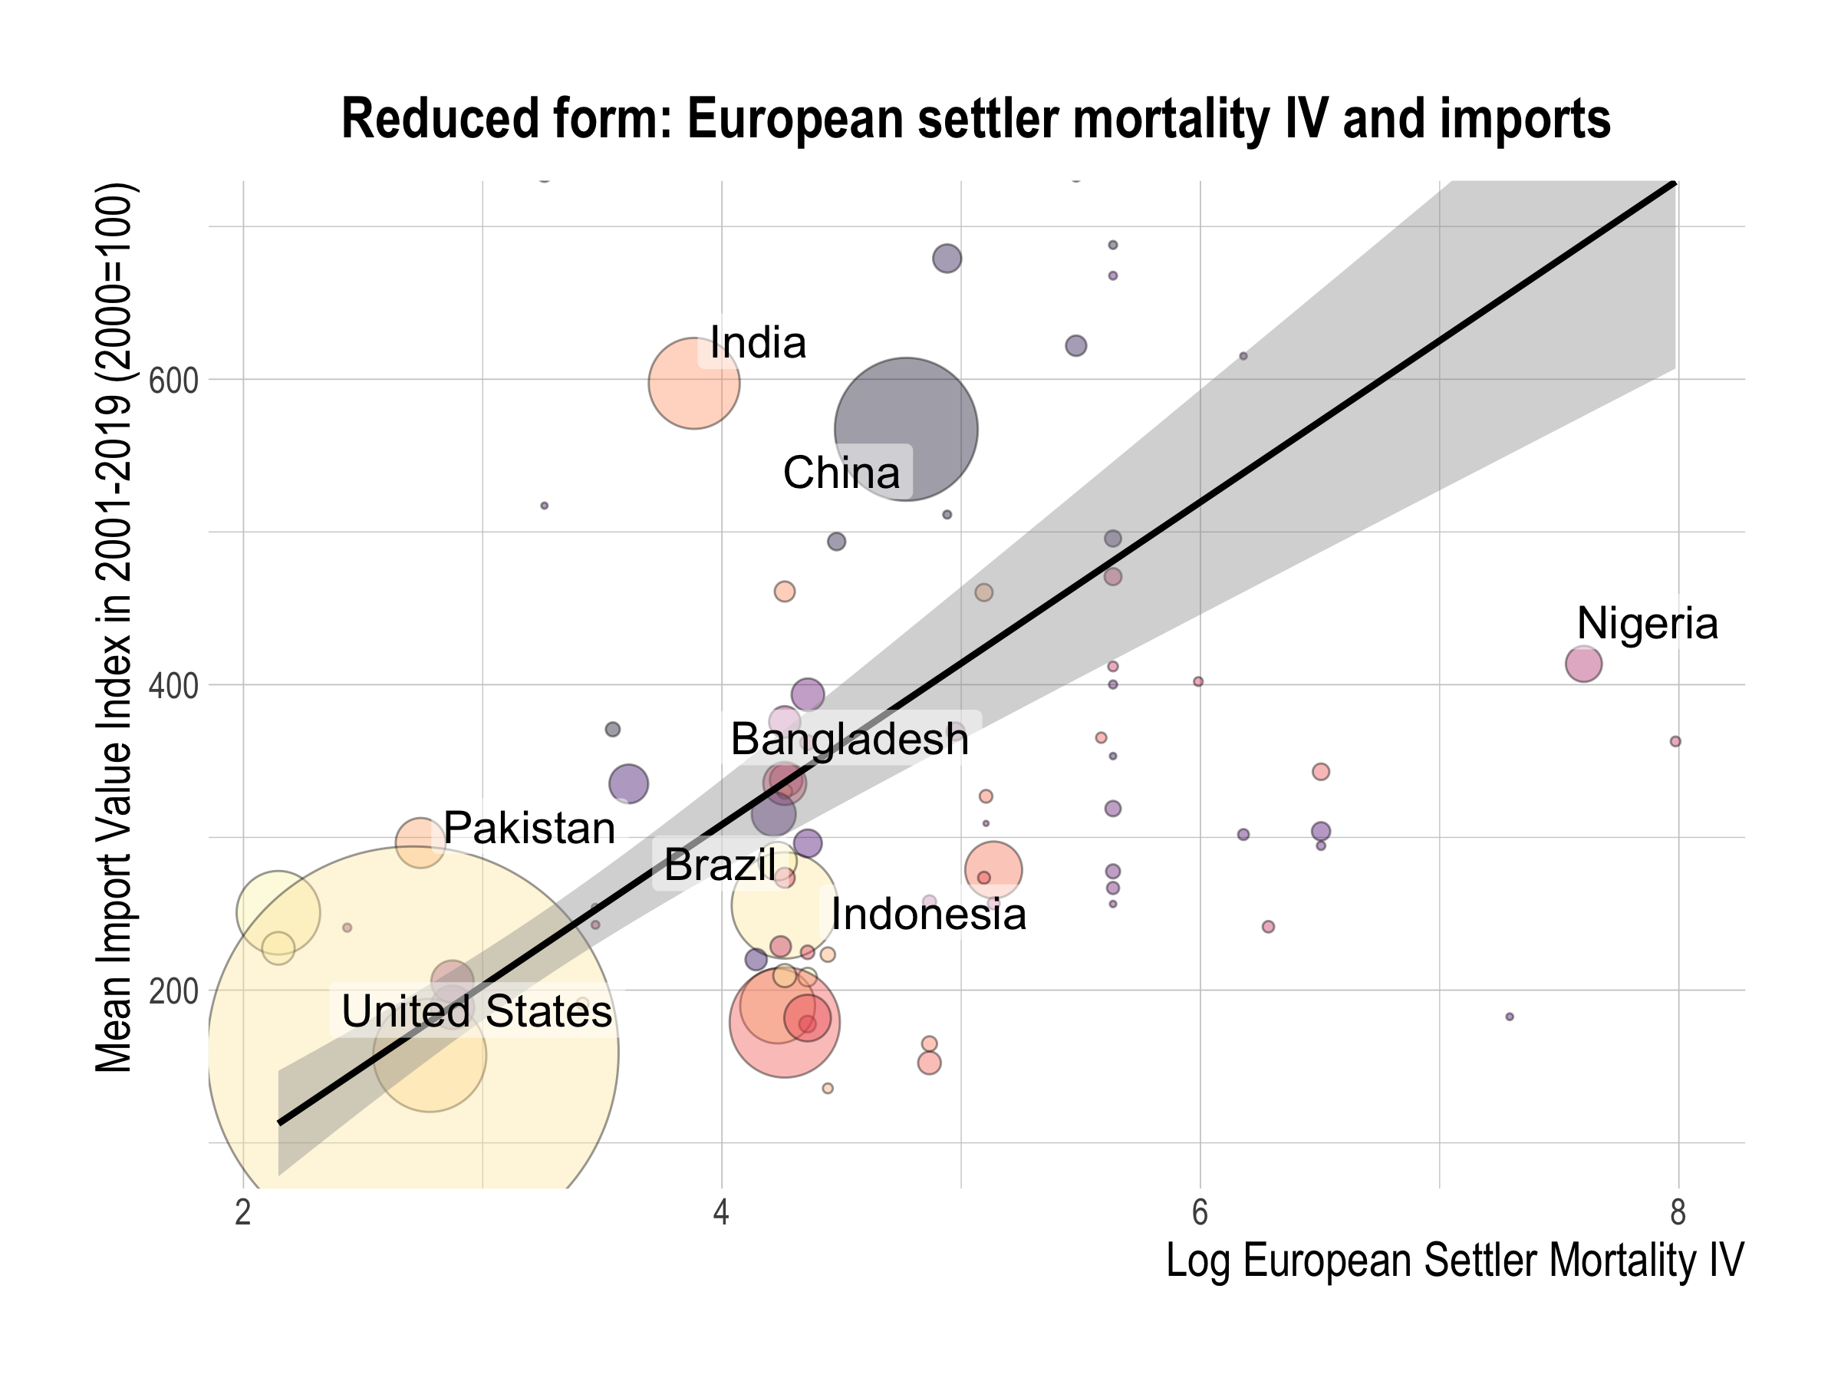

Slide 54
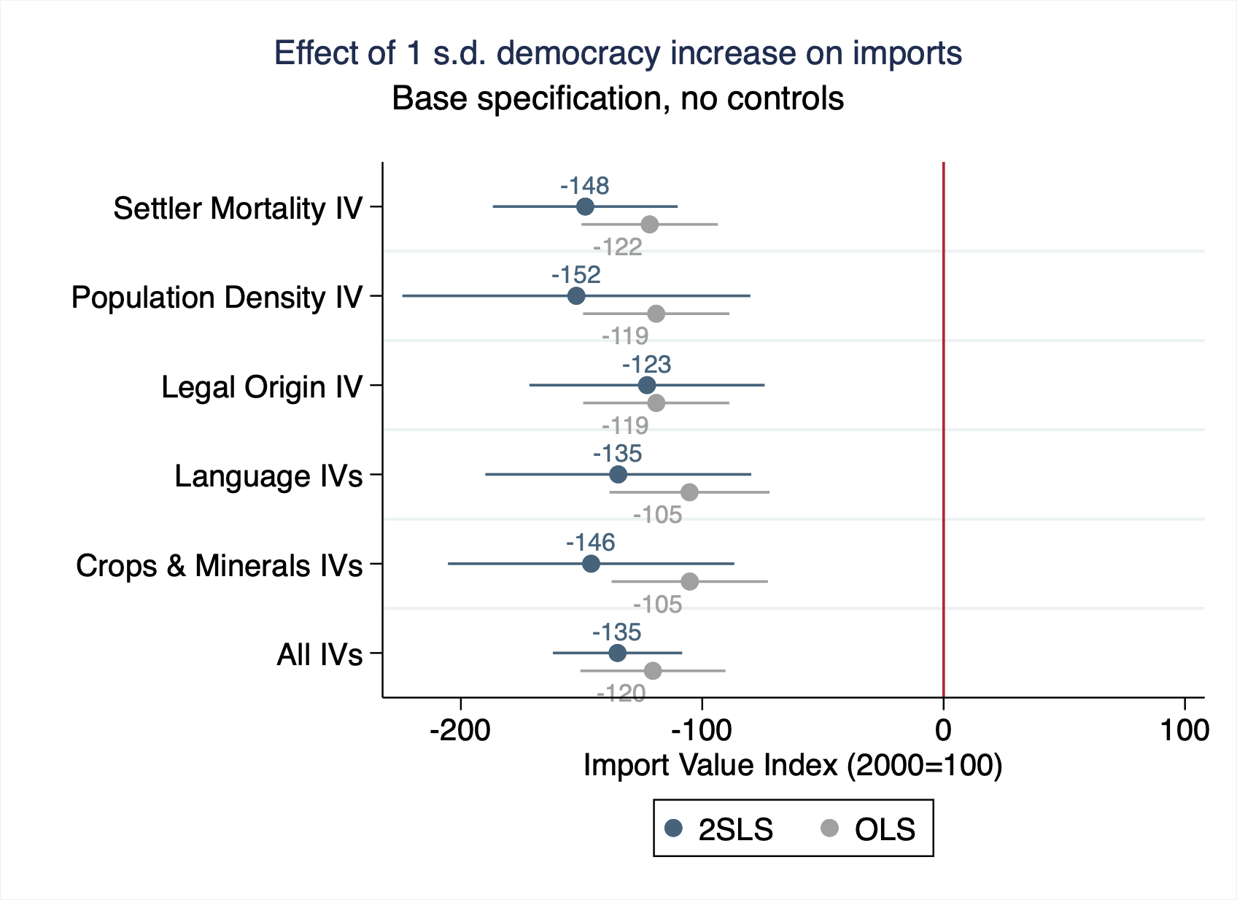
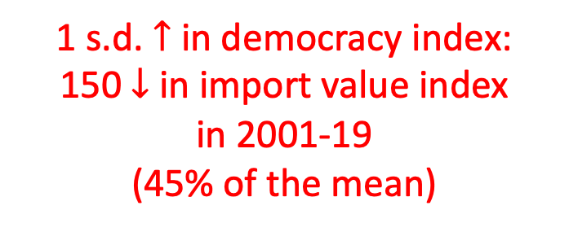
1 s.d. $↑$ in democracy index:
150 $↓$ in import value index
in 2001-19
(45% of the mean)

Slide 55
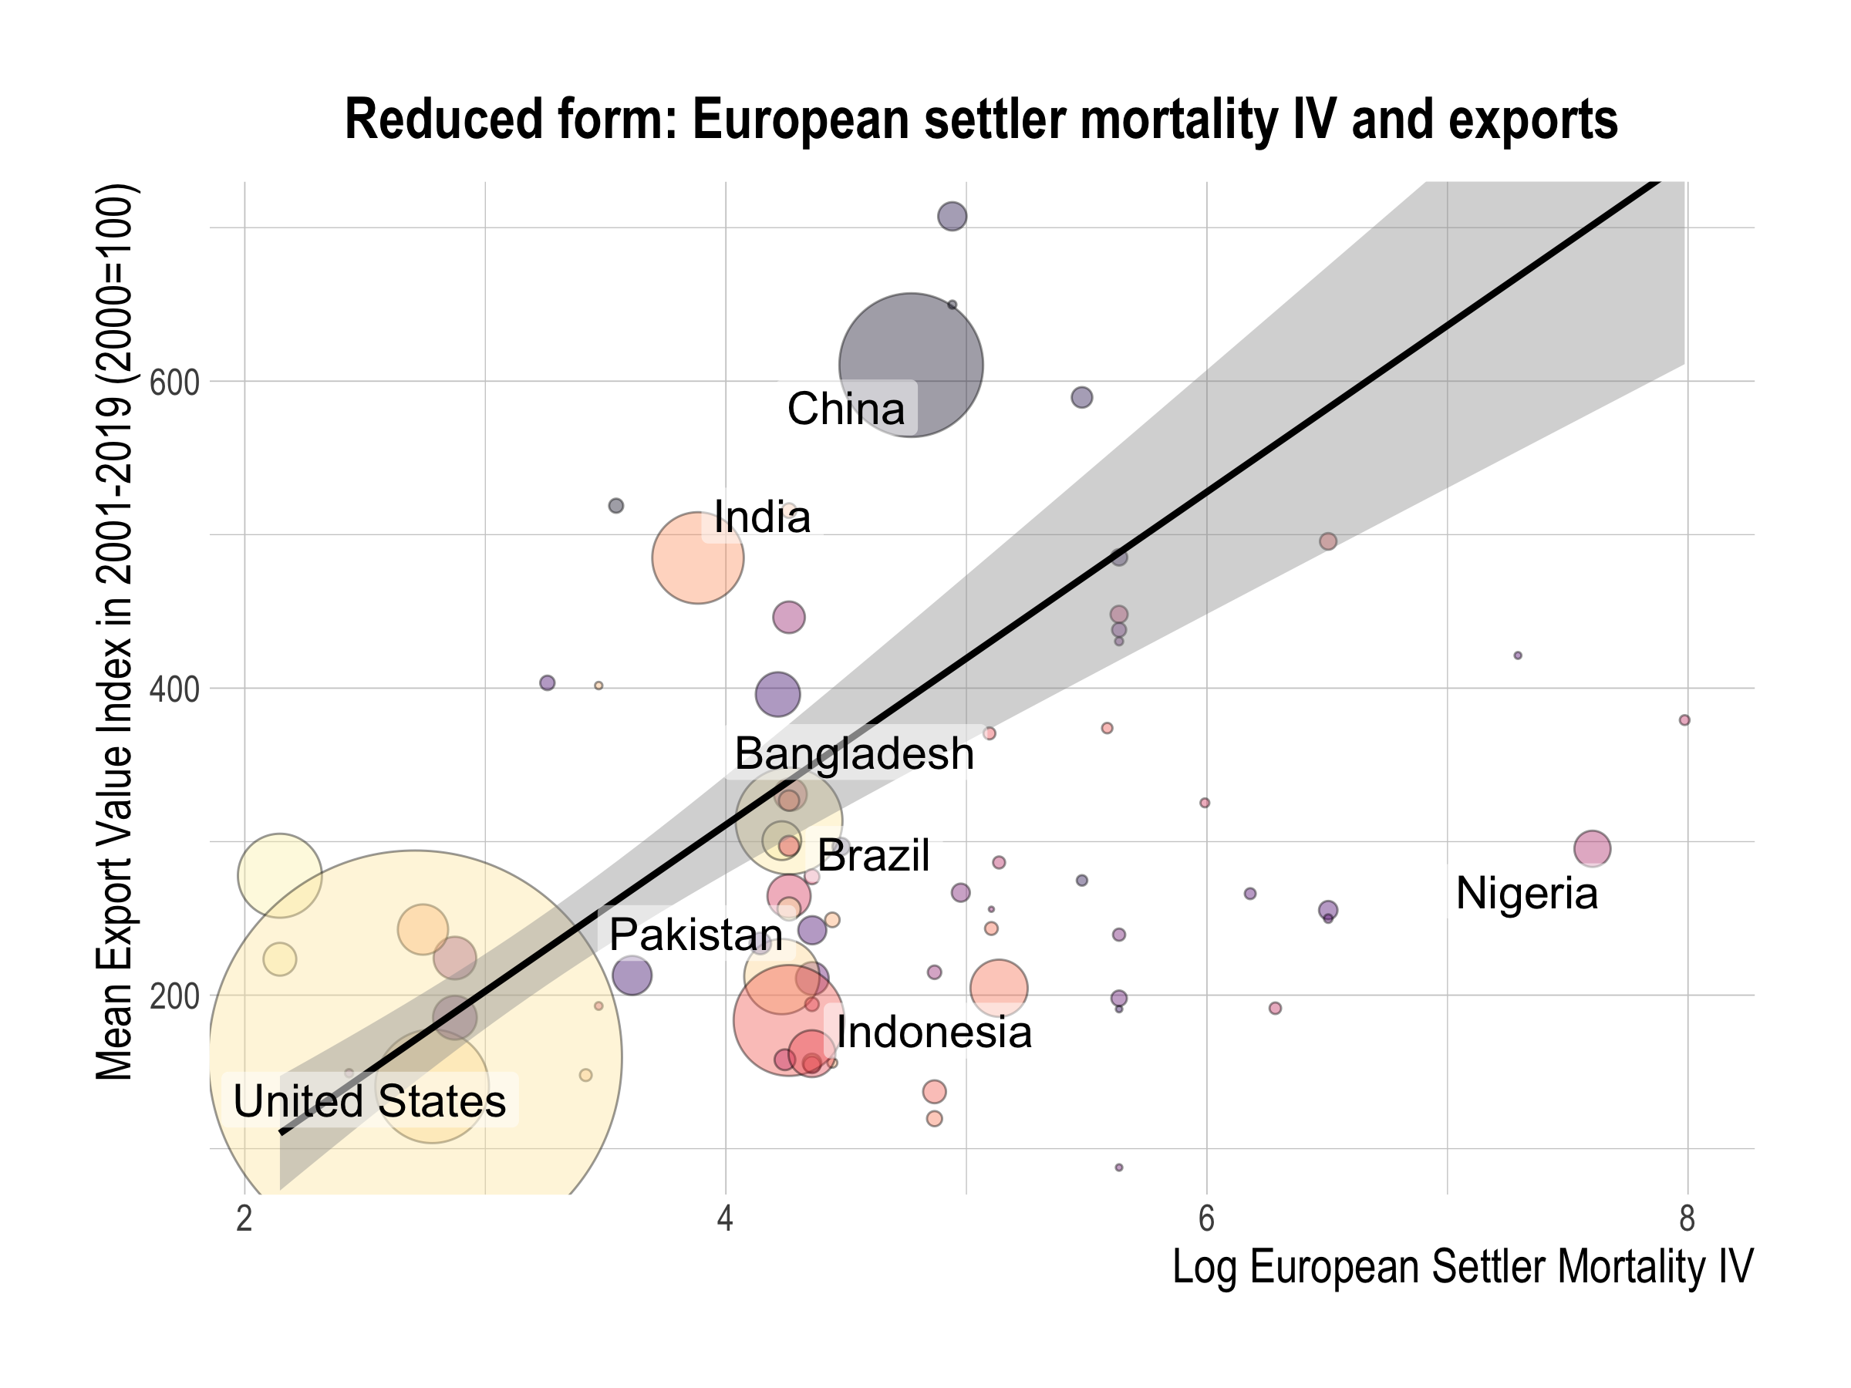

Slide 56
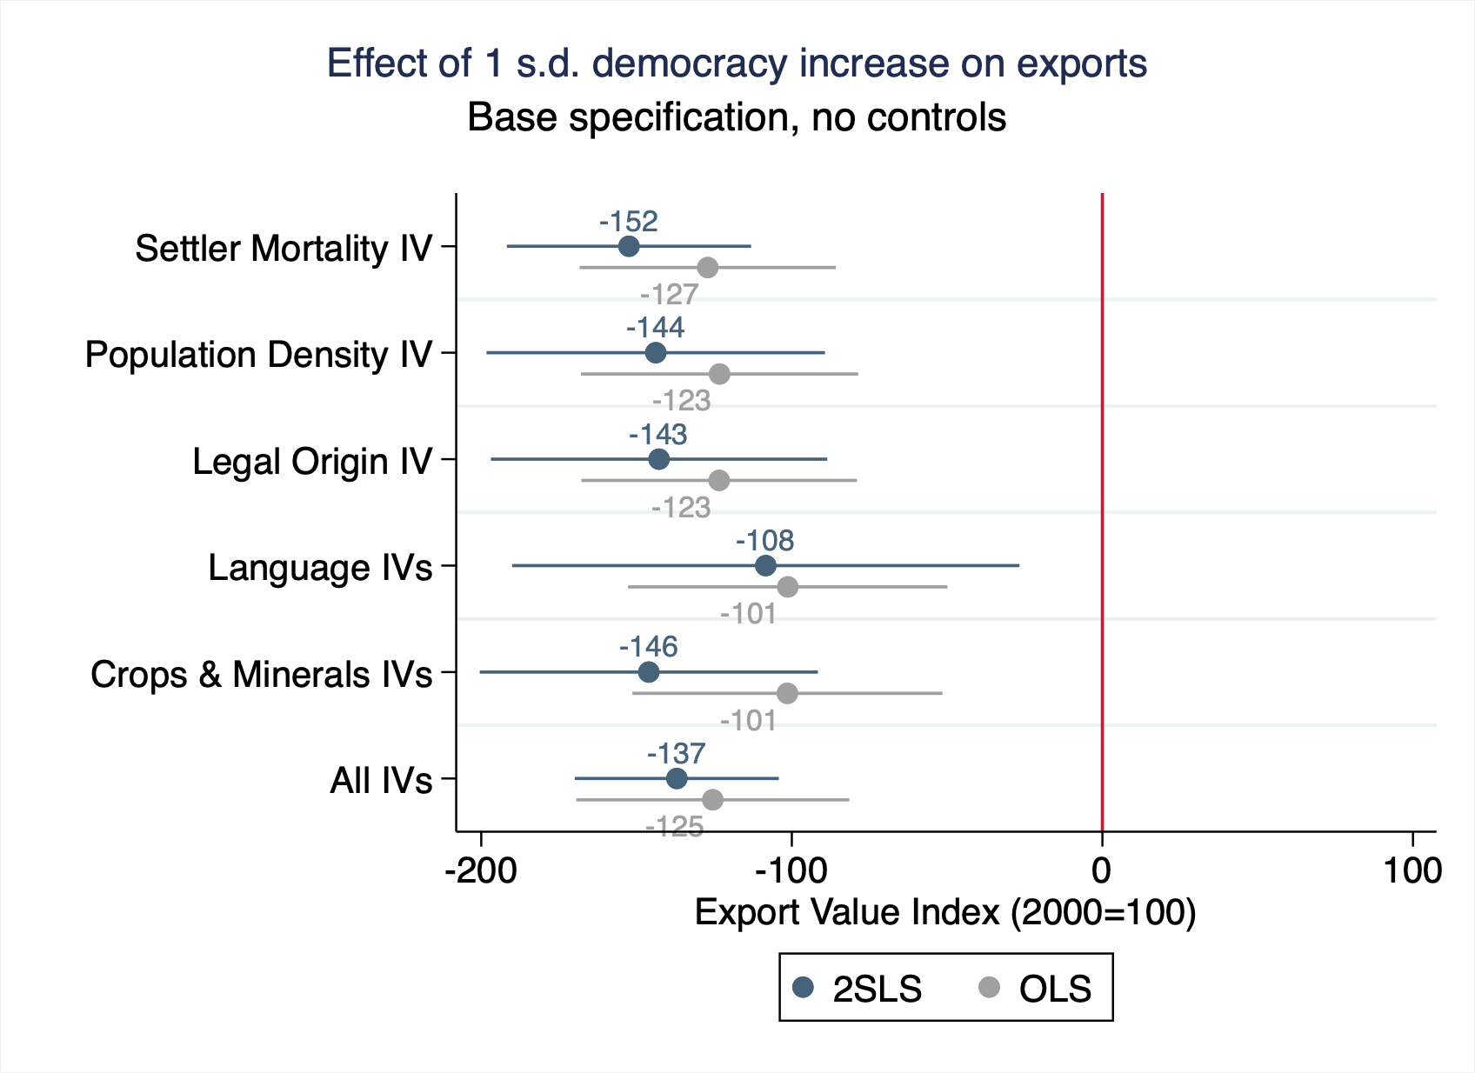
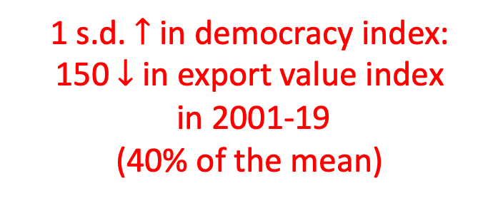
1 s.d. $↑$ in democracy index:
150 $↓$ in export value index
in 2001-19
(40% of the mean)

Slide 57
Outline
Data
Democracy is correlated with worse outcomes
Democracy causes the worse outcomes
IVs for political regimes
2SLS estimates
Channels behind democracy’s effect
Conclusion
Notes:
This presentation will proceed as follows:
1. Describe our data on Covid-19 outcomes and democracy
2. Explore the OLS relationship between democracy and Covid-19 outcomes to establish that democracy is significantly associated with worse outcomes.
3. Then, we explain our empirical strategy and describe our five different sets of IVs which we use to identify democracy’s effect.
4. After explaining the empirical strategy, we move on to democracy’s causal effect and the channels behind it.
Then, we conclude.

Slide 58
Curse of democracy in the 21st century
Democracy has persistent negative impacts on GDP growth since the beginning of the 21st century
For 2020, democracy is also found to cause more Covid-19-related deaths
Mechanisms are likely to be decreases in investments & trade, & slower value-added growth

Slide 59
Curse of democracy in the 21st century
Moving forward:
Democracy’s effects on perfomance in other aspects (e.g. inequality, happiness)?
Geopolitical movements away from democracy?
Policy Implication:
Not a general case against democracy
normative and procedural virtues
democracies may be better in the long run
Preferred interpretation:
Democracy has room for improvement in particular aspects in particular situations.
Notes:
Our analysis leads to a variety of avenues for future work.
First, it is important to update the analysis with better outcome data. The data we currently use for GDP growth rates in 2020 are estimates by the IMF. We will update our analysis once official GDP growth rates are released.
Moreover, we recognize reporting policy may affect the reported number of Covid-19-caused deaths. One potential solution is to look at data on excess mortality rates, such as the World Mortality Dataset (Karlinsky and Kobak, 2021). But the dataset is still limited in coverage and currently only covers excess mortality rates for about 80 countries.
More conceptually, we plan to measure democracy’s effects on other key aspects of policy performance, such as economic inequality and citizen’s happiness.
Finally, we need to see if the negative impact of democracy will result in geopolitical movements away from democracy. We leave these challenging directions to future work.

Slide 60
Appendix

Slide 61
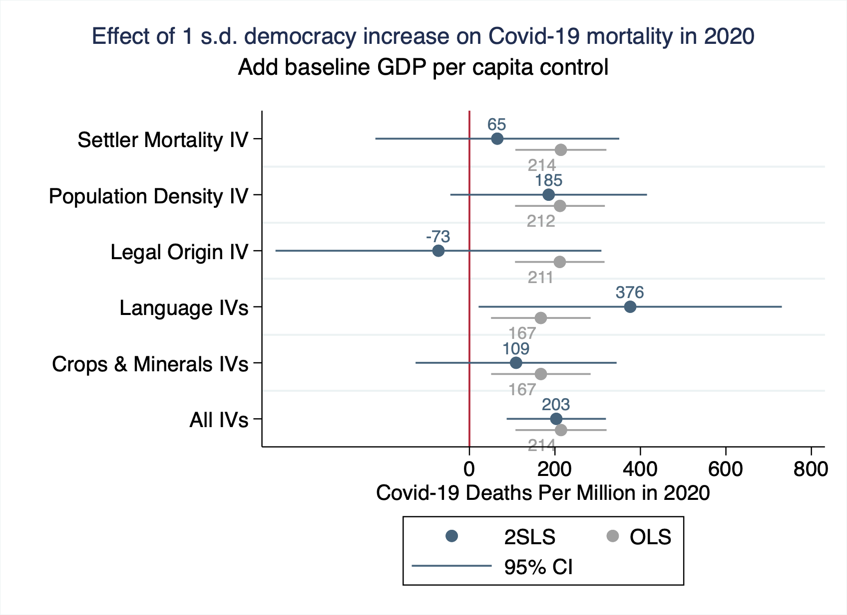

Slide 62
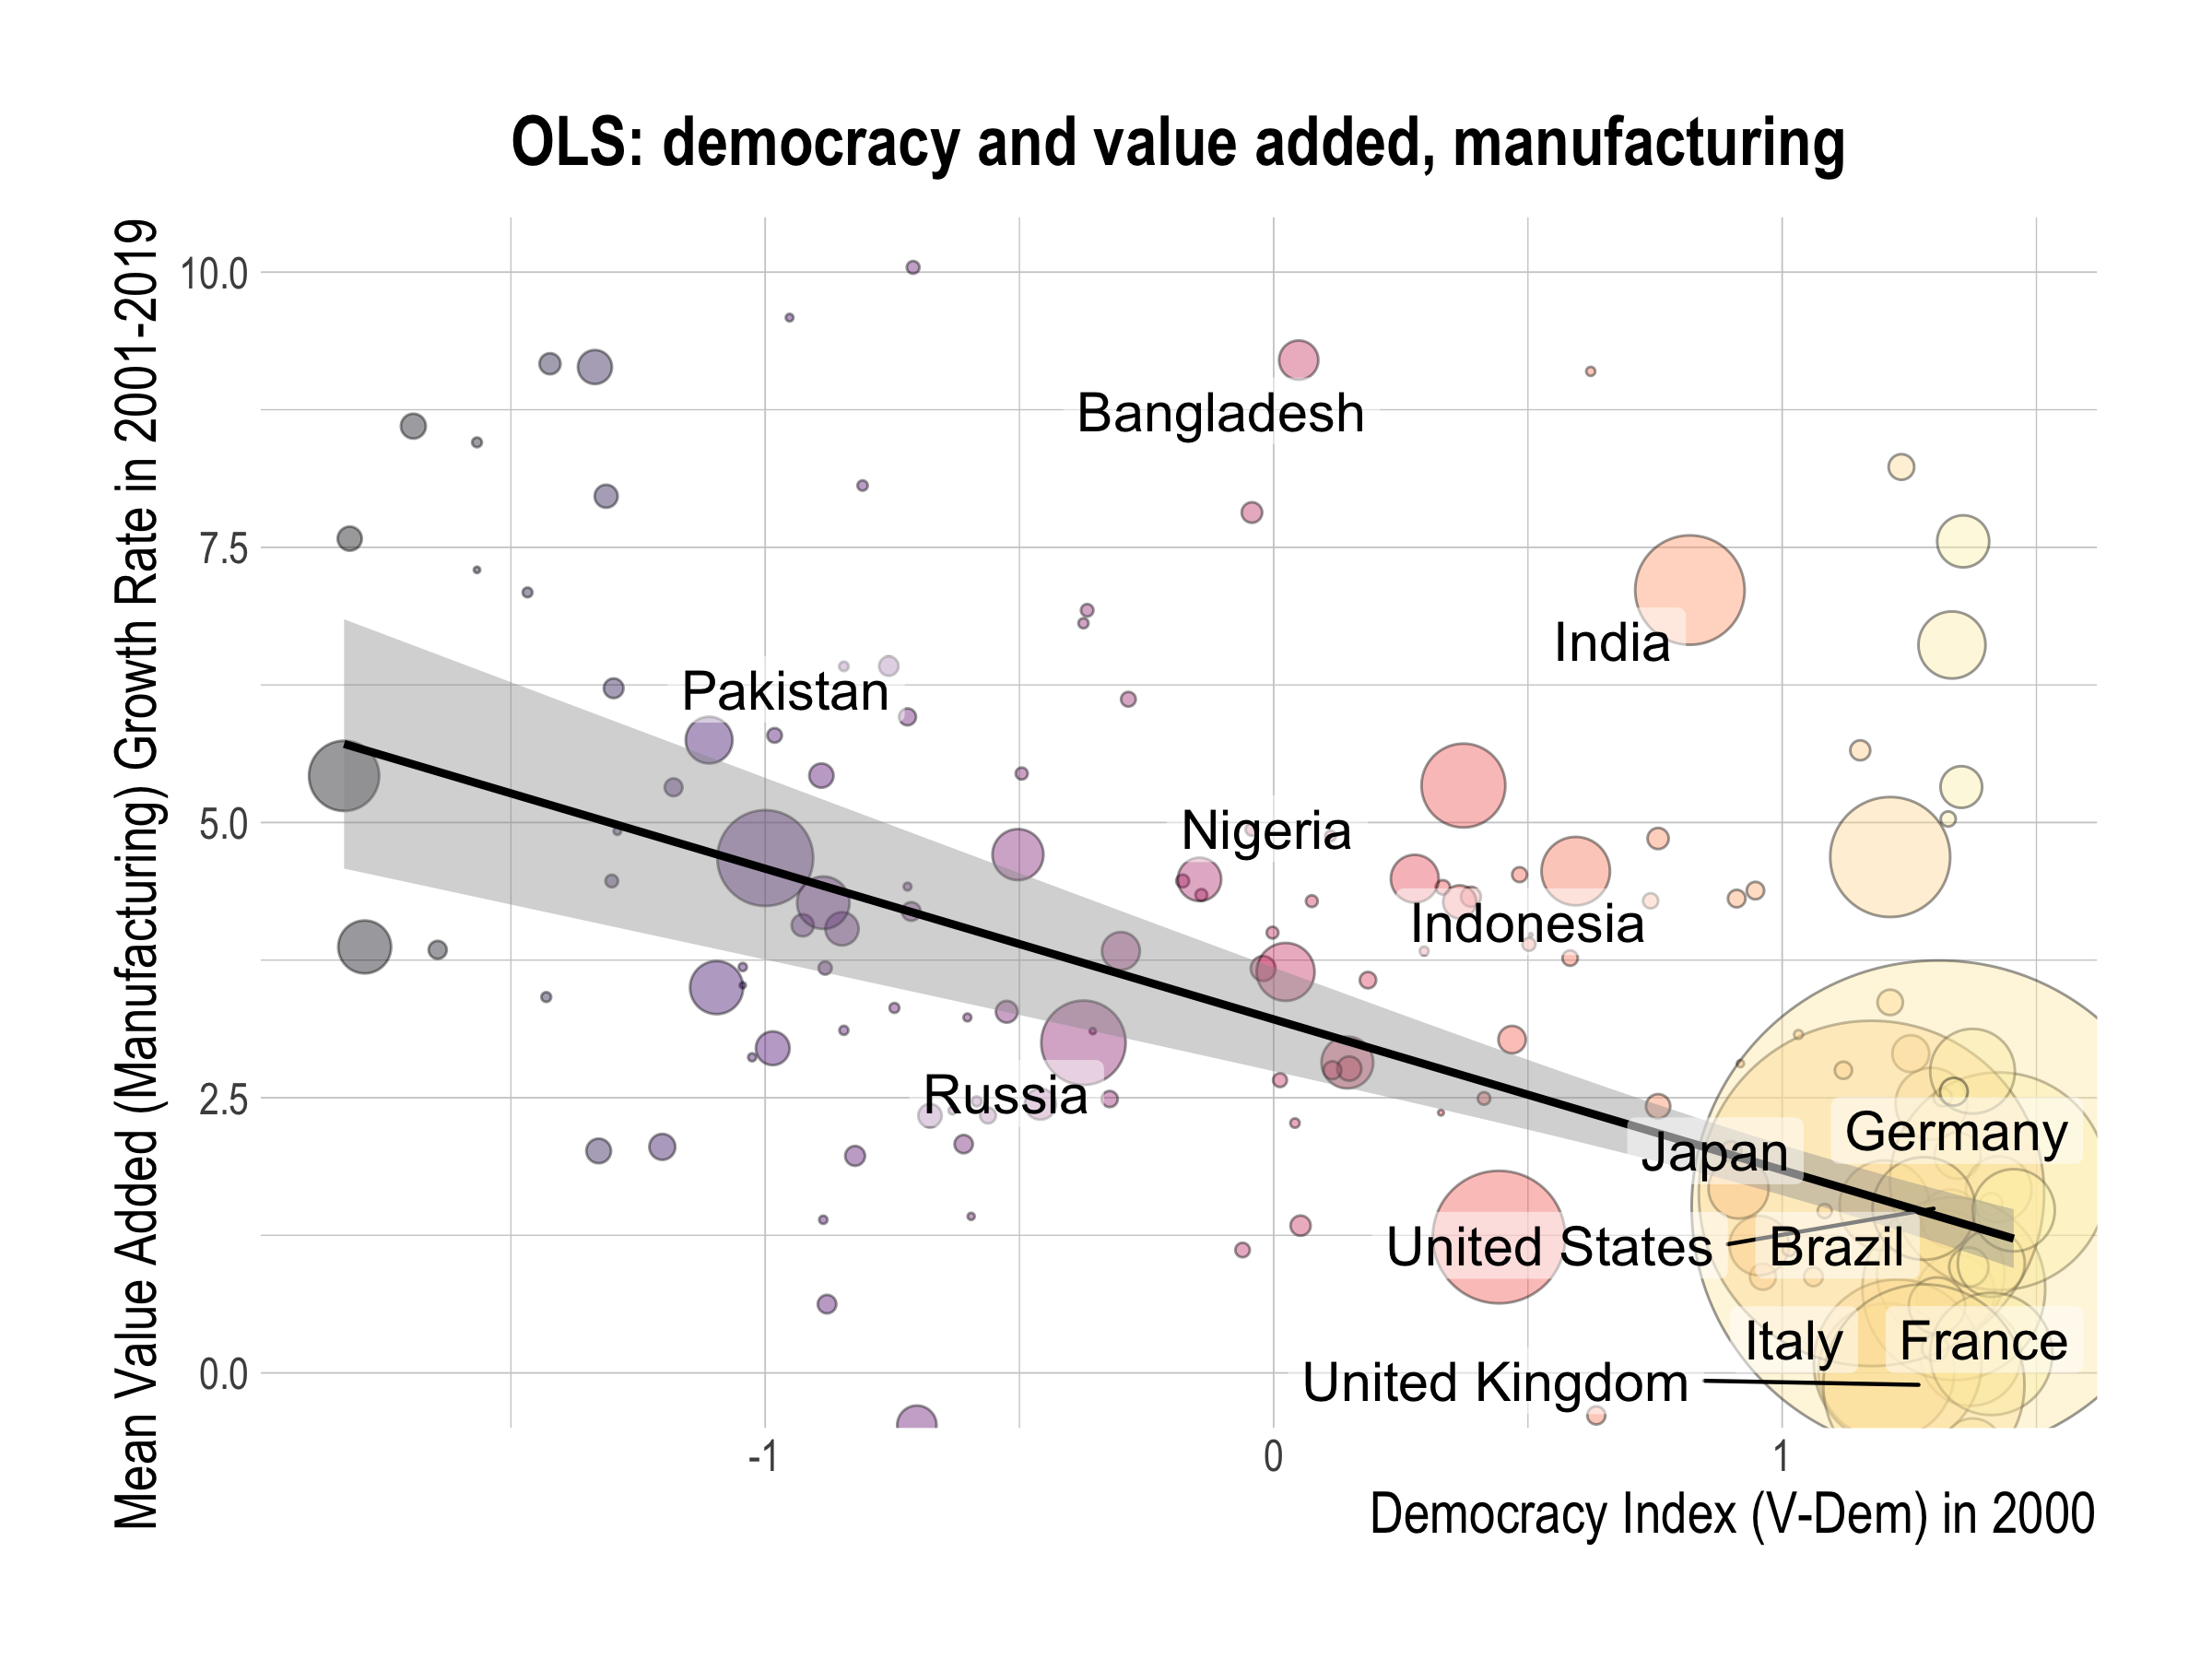

Slide 63
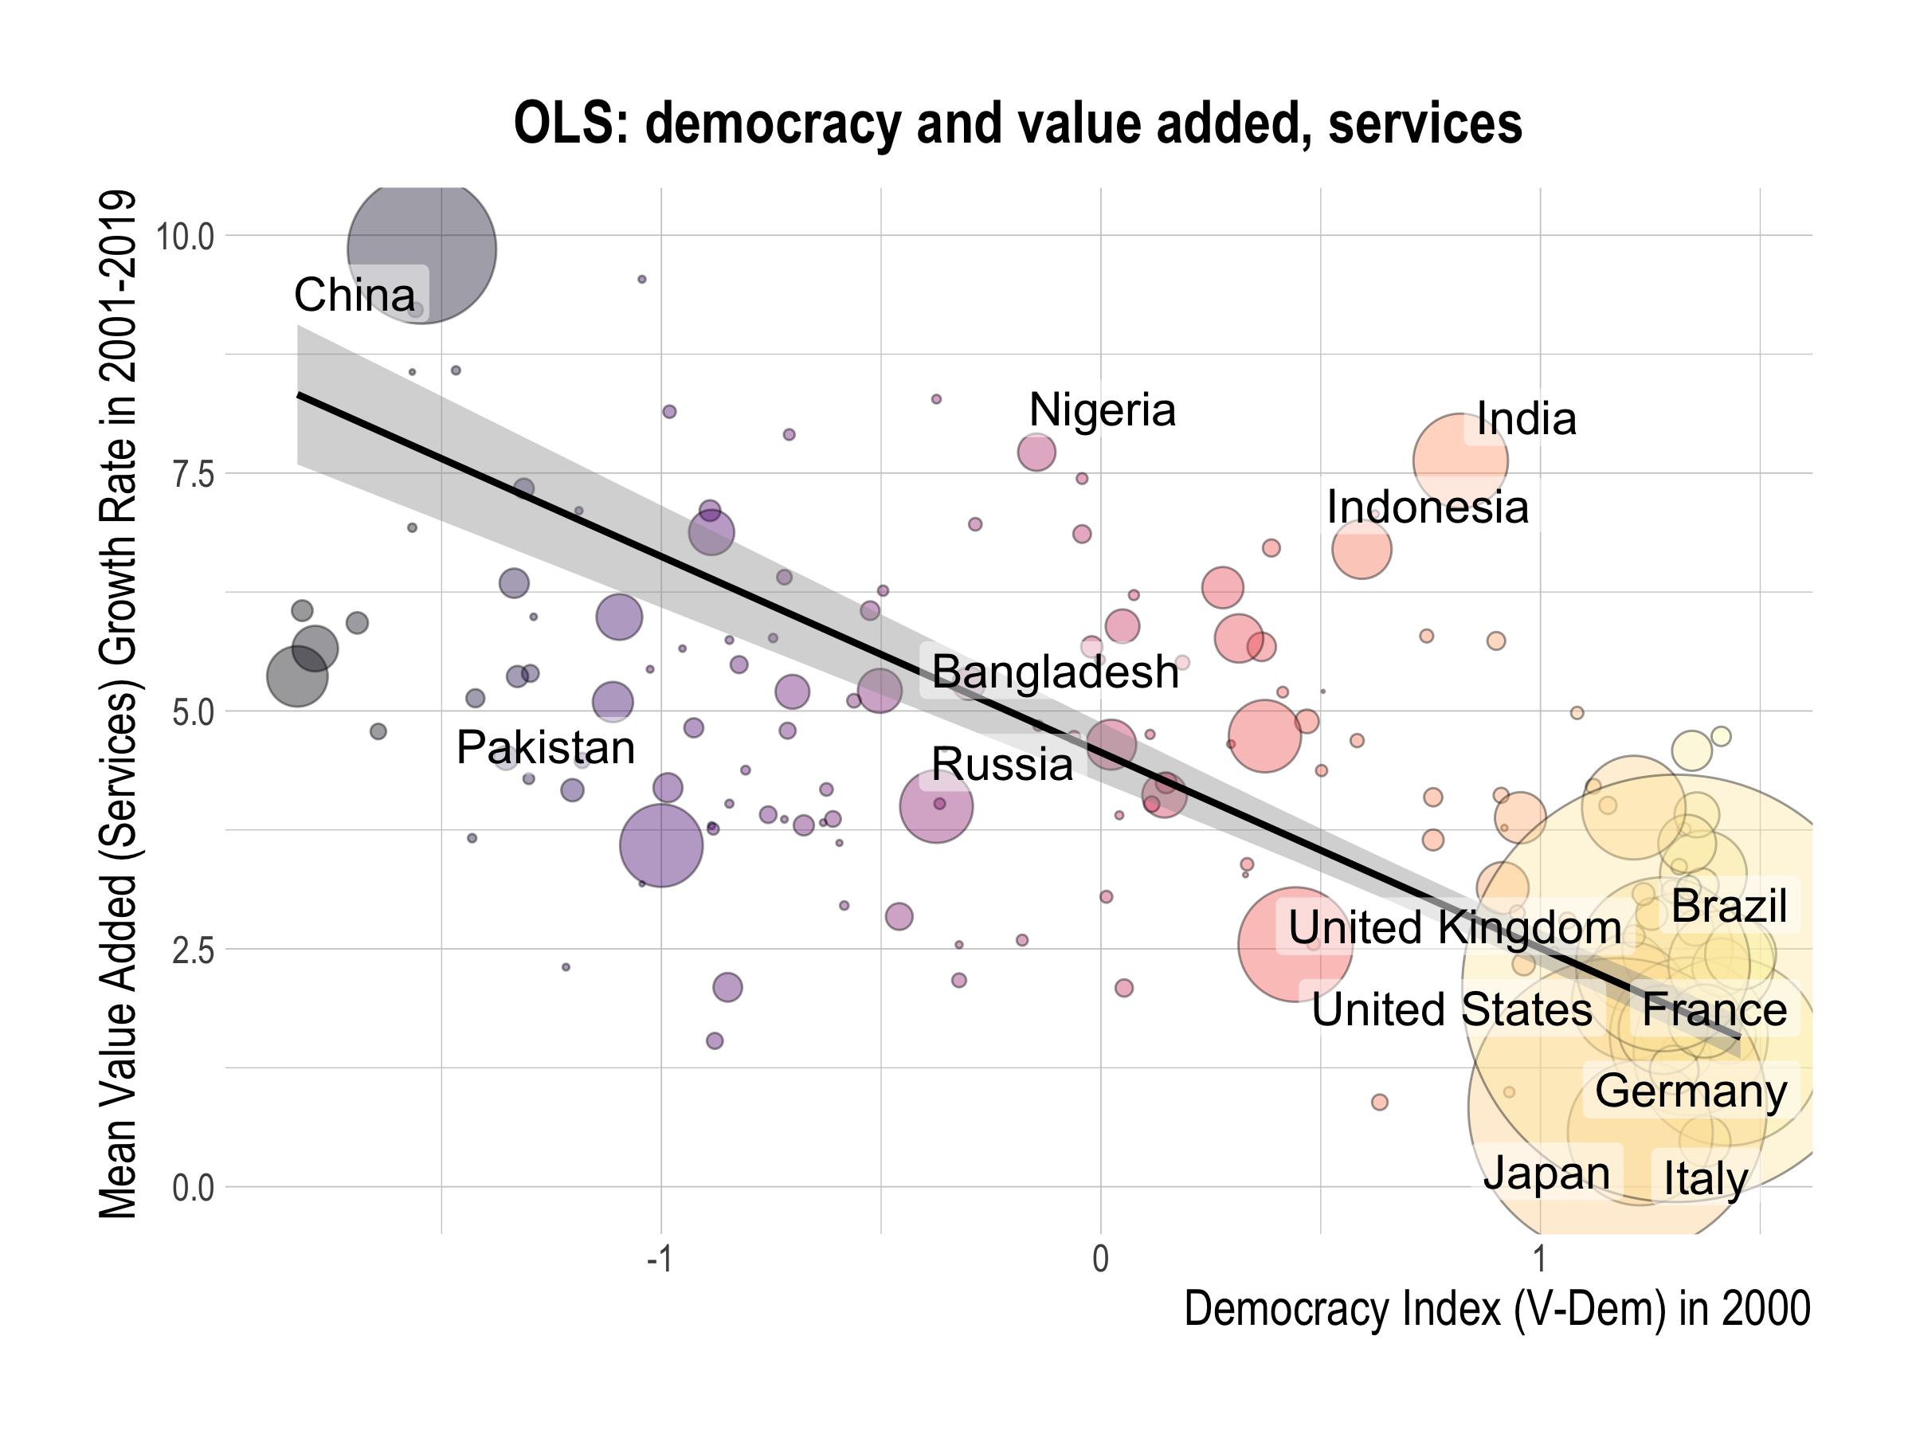

Slide 64
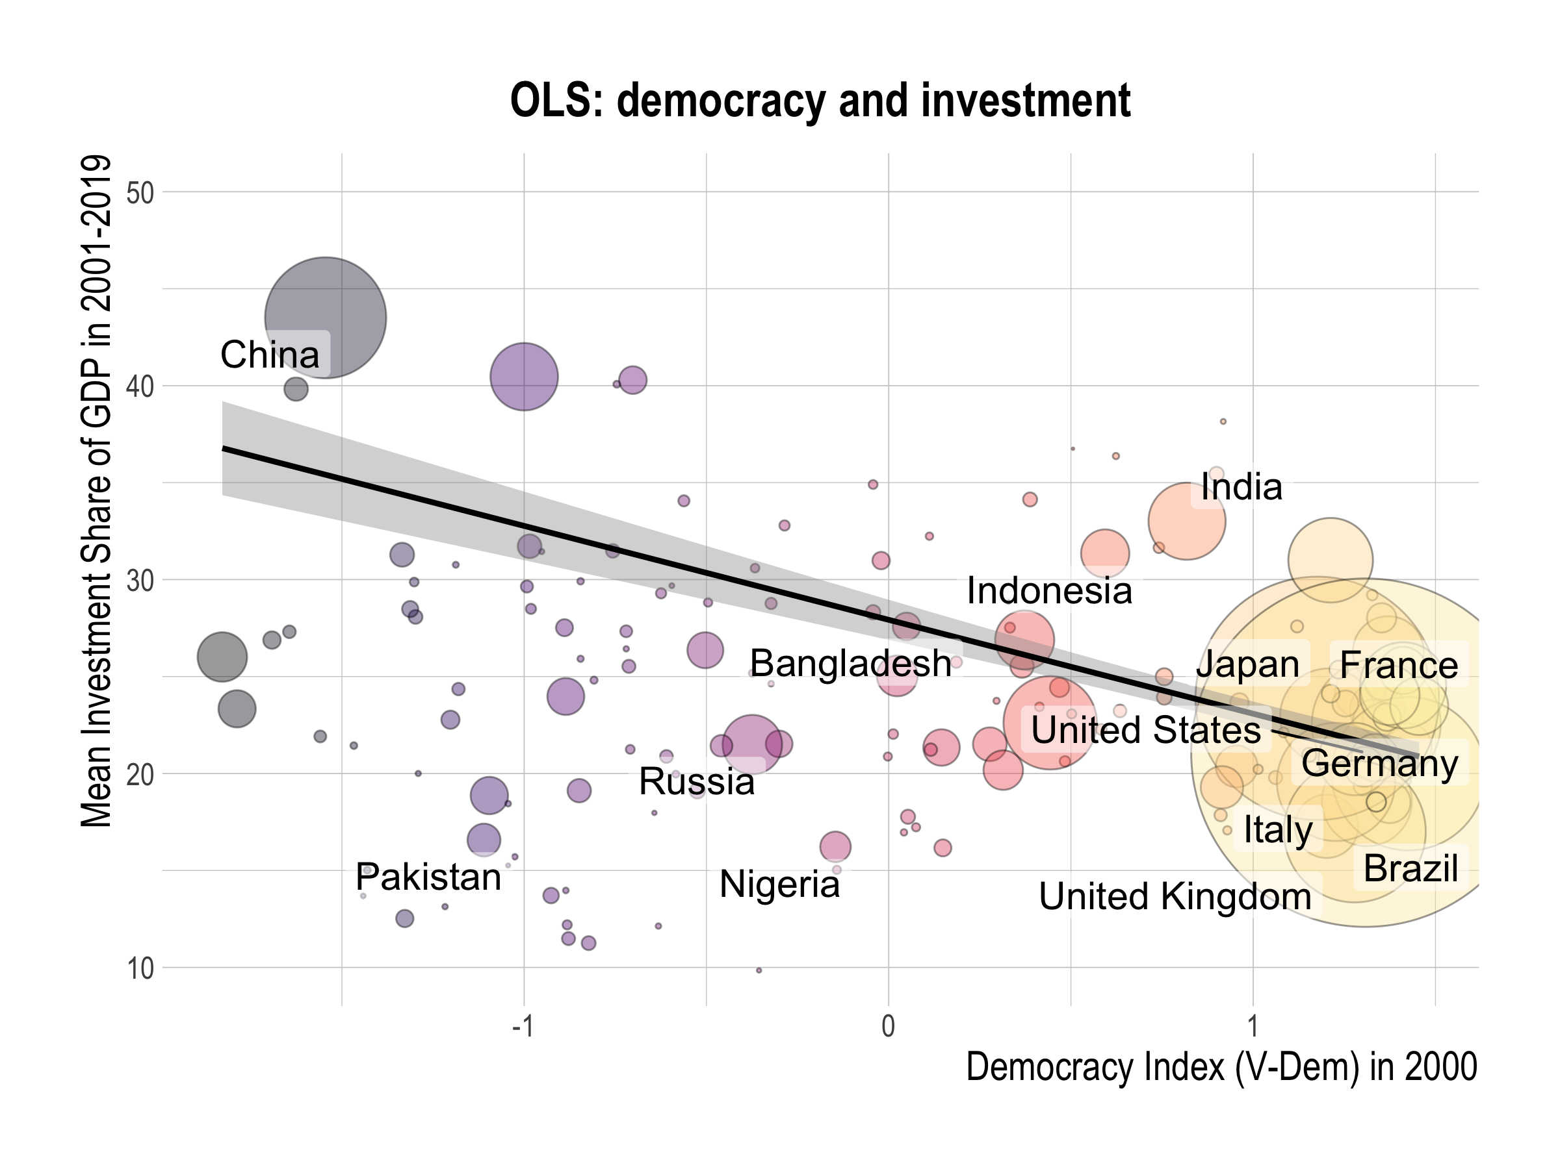

Slide 65
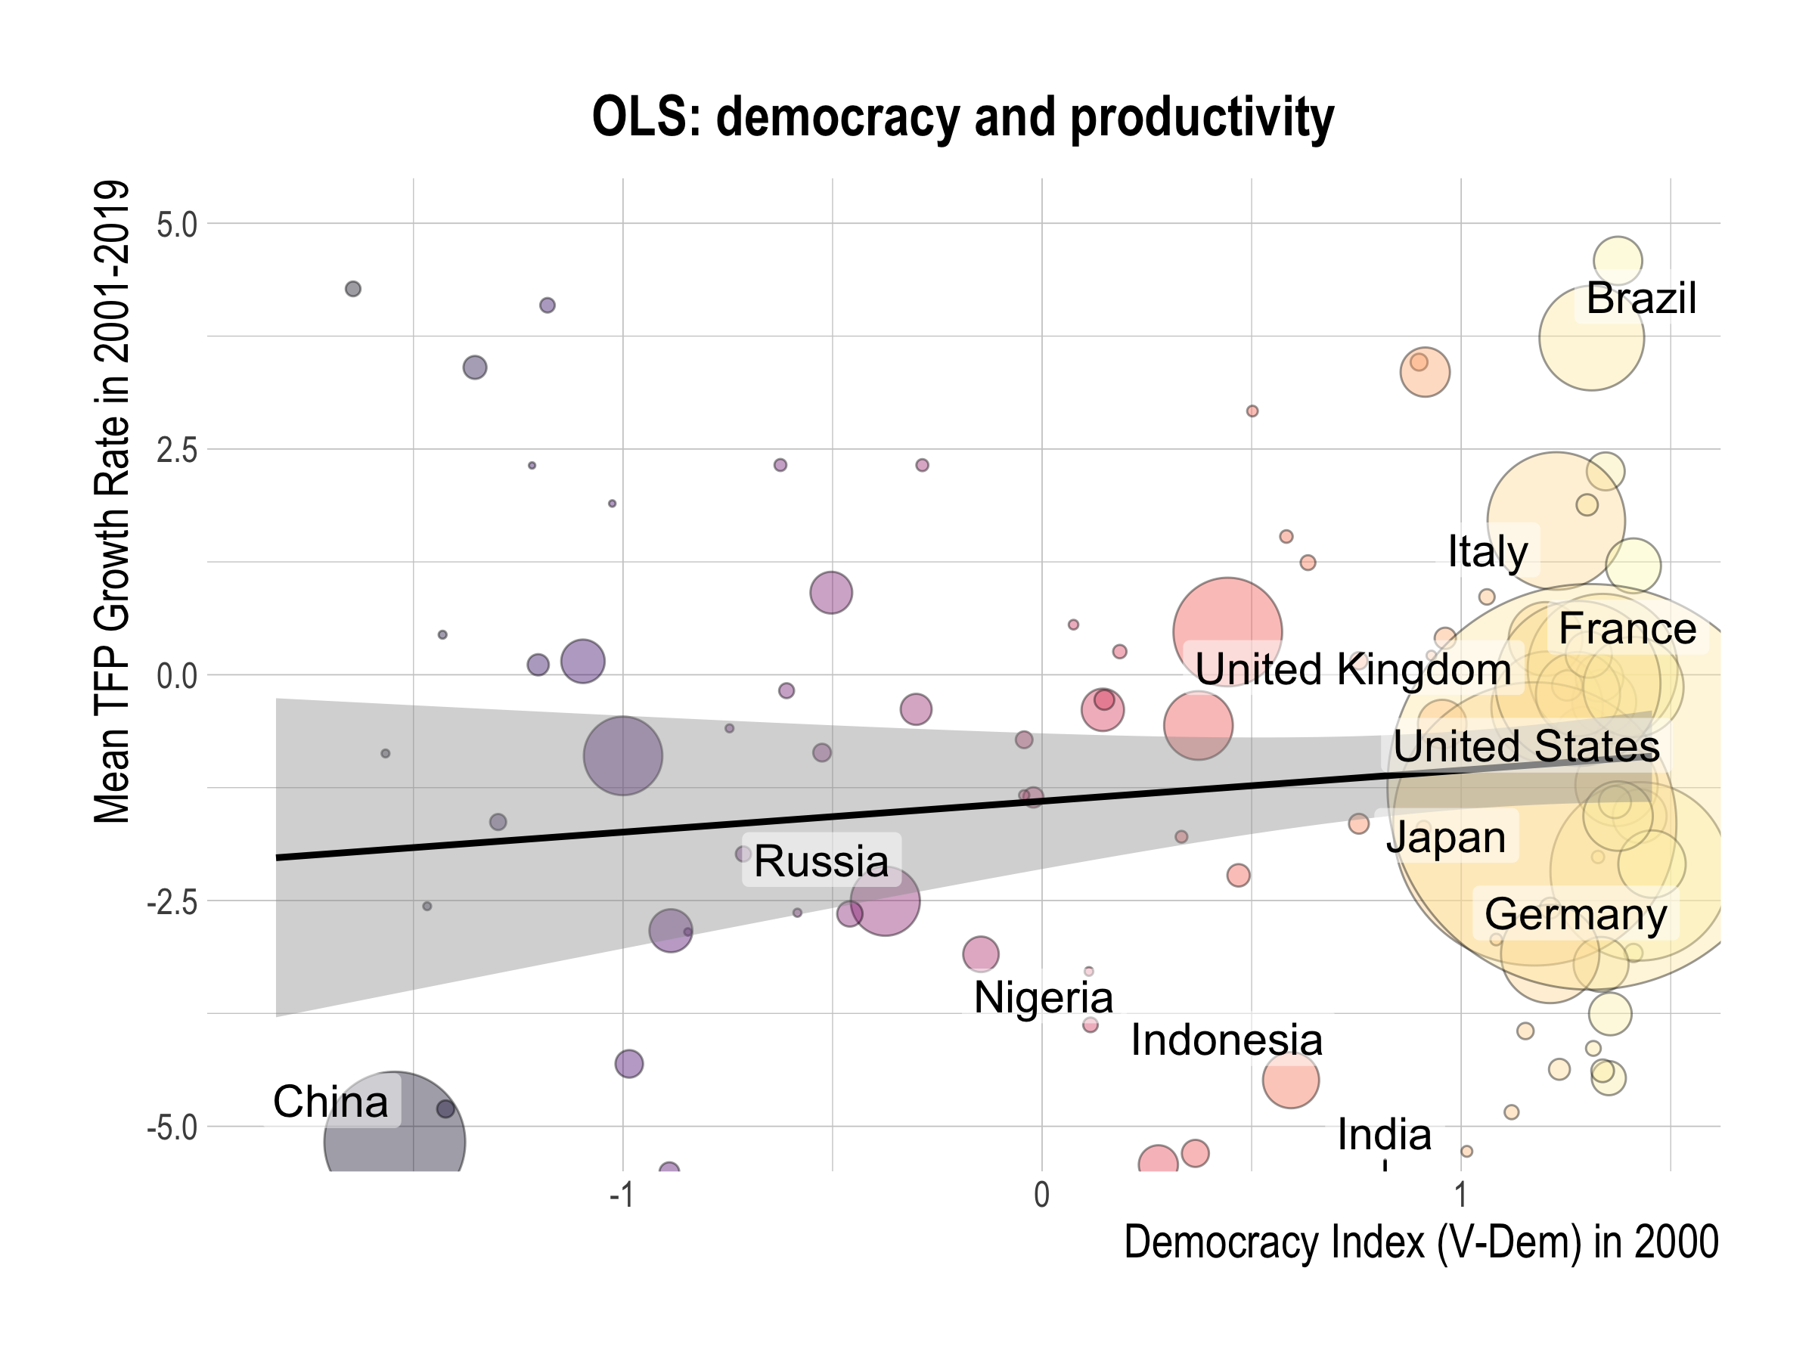

Slide 66


Slide 67


